Slide 1
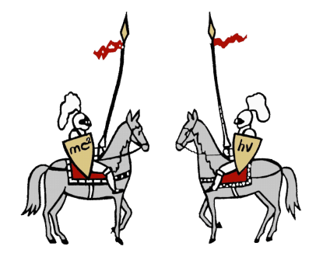
Problem 10: Droplet Explosion

Slide 2
Table of Contents
Problem Description
Analysis of Results
Conclusions
Theoretical Model
Experiment Setup

Slide 3
Problem description
Binary mixture
When a drop of a water mixture (e.g. water-alcohol) is deposited on the surface of a hydrophobic liquid (e.g. vegetable oil), the resulting drop may sometimes fragment into smaller droplets.
Hydrophobicity and surface tension
Instability
Investigate the parameters that affect the fragmentation and the size of the final droplets.
1) How does the droplet expand?
2) What causes the fragmentation of the droplet?
3) What parameters affect the fragmentation?
IYPT 2022 Droplet Explosion – Problem Description 3

Slide 4
Table of Contents
Problem Description
Analysis of Results
Conclusions
Theoretical Model
Experiment Setup

Slide 5
Qualitative model of expansion
Air (3)
Liquid 2
Liquid 1
$$dW=\left(σ_{12}+σ_{23}−σ_{13}\right) dS$$
$$dW<0$$
$$dW=0$$
$$dW>0$$
layer
layer
lens
IYPT 2022 Droplet Explosion – Theoretical Model 5

Slide 6
Droplet expansion
Air
$$dW≪0$$
Water + ethanol
Oil
Air
Water + ethanol
$$dW<0$$
Oil
Air
$$dW>0$$
Water + ethanol
Oil
IYPT 2022 Droplet Explosion – Theoretical Model 6

Slide 7
Marangoni forces
γ₁
$$F_{s}$$
$$F_{s}$$
γ₂
γ₂
γ₁ < γ₂
IYPT 2022 Droplet Explosion – Theoretical Model 7

Slide 8
Marangoni effect
Marangoni stress:
$τ_{Ma}=\frac{dγ}{dc_{e}}∇_{t}c_{a}+\frac{dγ}{dT}∇_{t}T$ in point $z=h(r,t)$
Concentraction gradient:
Temperature gradient:
$$\frac{dγ}{dc_{a}}=−5.1876E^{−14}c_{a}^{ 2}+$$
$$1.2E^{−9}c_{a}−7.6396E^{−6}$$
$$\frac{dγ}{dT}=−4.7E^{−10}T−1.63E^{−5}$$
$$\frac{∂c_{a}}{∂t}+\vec{v}∙∇c_{a}=∇∙\left(D_{a}∇c_{a}\right)$$
$$ρκ\left(\frac{∂T}{∂t}+\vec{v}∙∇T\right)=∇∙\left(λ∇T\right)$$
Vazquez, G.; Alvarez, E.; Navaza, J. M. (1995). Surface tension of alcohol + water from 20 to 50. degrees C., J. Chem. Eng. Data 40
COMSOL Microfluidics Module User’s Guide v. 5.2. COMSOL Multiphysics: COMSOL AB; Stockholm, Sweden, 2016
IYPT 2022 Droplet Explosion – Theoretical Model 8

Slide 9
Droplet volume change
Change of volume:
$$\frac{dV}{dt}=−\int{\frac{2πrM_{H2O}D_{H2O}}{ρ_{H2O}}}∇_{n}k_{p,H2O} dl−\int{\frac{2πrM_{a}D_{a}}{ρ_{a}}}∇_{n}k_{p,a }dl$$
$$\int{\frac{2πrM_{H2O}D_{H2O}}{ρ_{H2O}}}∇_{n}k_{p,H2O} dl≪\int{\frac{2πrM_{a}D_{a}}{ρ_{a}}}∇_{n}k_{p,a }dl$$
Surface evaporation:
$${\left.\frac{dV}{dt}\right|}_{S}=−\int_{0}^{R\left(t\right)}{\frac{J\left(r\right)}{ρ}\sqrt{1+{\left(\frac{∂h}{∂r}\right)}^{2}}}2πr dr=−\frac{4D_{a}\left(k_{p}−k_{p,∞}\right)R\left(t\right)}{ρ}$$
IYPT 2022 Droplet Explosion – Theoretical Model 9

Slide 10
Speed of expansion
Height-averaged velocity:
$$v_{avg}≈\frac{h}{2μ}\frac{∂γ}{∂r}−\left[ρg\frac{∂h}{∂r}−\frac{∂}{r}\left[γ\left\{\frac{∂^{2}h}{∂r^{2}}+\frac{1}{r}\frac{∂h}{∂r}\right\}\right]\right]$$
Assumptions:
$$v_{avg}\sim \frac{dR}{dt}, \frac{∂γ}{∂r}\sim \frac{∆γ\left(t\right)}{R\left(t\right)}, h\left(t\right)=\frac{V\left(t\right)}{πR^{2}\left(t\right)}$$
Change of radius in time:
$$R_{max} \sim a{\left[\frac{\left(Φ_{0}−Φ_{c}\right)∆γHΩ_{0}}{\left(1−Φ_{c}\right)μ_{0}j_{v}}\right]}^{\frac{1}{4}}$$
$R\left(t\right)≈{\left[{r_{0}}^{4}+\frac{2}{μπ}\int_{0}^{t}{V\left(t\right) ∆γ dt}\right]}^{\frac{1}{4}}$
Keiser L. et al (2017). Marangoni Bursting: Evaporation-Induced Emulsification of Binary Mixtures on a Liquid Layer, Phys. Rev. Lett. 118
IYPT 2022 Droplet Explosion – Theoretical Model 10

Slide 11
Droplet fragmentation - instability
Plateau-Rayleigh instability:
Fingering instability:
$$2πR_{0}=nλ$$
$$l_{c}=\sqrt{\frac{γ}{\left(ρ_{o}−ρ_{s}\right)g}}$$
$$r_{0}$$
$$\frac{R_{0}}{r_{0}}$$
$$R_{0}$$
$$R_{0}$$
$$2l_{c}$$
Pairam, E.; Fernández-Nieves, A. (2009). Generation and Stability of Toroidal Droplets in a Viscous Liquid. Phys. Rev. Lett., 102(23)
IYPT 2022 Droplet Explosion – Theoretical Model 11

Slide 12
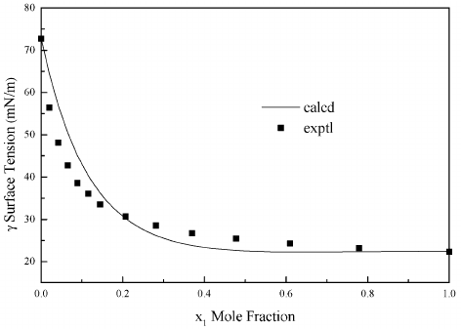
Droplet fragmentation – droplet size
Young-Laplace equation:
$$∆p=σ\left(\frac{1}{R_{1}}+\frac{1}{R_{2}}\right)$$
$$p_{o}$$
$$p_{i}$$
$$R$$
$$∆R$$
Surface tension of ethanol (1) + water (2) mixtures at 293.15 K . (Vazquez et al., 1995).
$$∆p=\frac{2σ}{R}$$
$$σ \sim R$$
IYPT 2022 Droplet Explosion – Theoretical Model 12

Slide 13
Phenomenon mechanism
Binary water-alcohol mixutre
Droplet expansion
Alcohol evaporation
$$\frac{dγ}{dc_{a}}=−5.1876E^{−14}c_{a}^{ 2}+$$
$$1.2E^{−9}c_{a}−7.6396E^{−6}$$
Temperature and concentration gradient
$$\frac{∂c_{a}}{∂t}+\vec{v}∙∇c_{a}=∇∙\left(D_{a}∇c_{a}\right)$$
Surface tension gradient
$$τ_{Ma}=\frac{dγ}{dc_{e}}∇_{t}c_{a}+\frac{dγ}{dT}∇_{t}T$$
$R\left(t\right)≈{\left[{r_{0}}^{4}\left(t\right)+\frac{2}{μπ}\int_{0}^{t}{V\left(t\right) ∆γ dt}\right]}^{\frac{1}{4}}$
$$φ_{0}=\frac{V(alkohol)}{V\left(alkohola\right)+V(voda)}$$
$$∆p=σ\left(\frac{1}{R_{1}}+\frac{1}{R_{2}}\right)$$
$$J_{a}=−M_{a}D_{a}∇_{n}k_{p,a}$$
Marangoni stress
$$2πR_{0}=nλ$$
$$dW=\left(σ_{12}+σ_{23}−σ_{13}\right) dS$$
$$ρκ\left(\frac{∂T}{∂t}+\vec{v}∙∇T\right)=∇∙\left(λ∇T\right)$$
Formation of boundary torus
$$\frac{dγ}{dT}=−4.7E^{−10}T−1.63E^{−5}$$
Plateu-Rayleigh and fingering instability
Droplet expulsion
‘Droplet implosion’
IYPT 2022 Droplet Explosion – Theoretical Model 13

Slide 14
Table of Contents
Problem Description
Analysis of Results
Conclusions
Theoretical Model
Experiment Setup

Slide 15
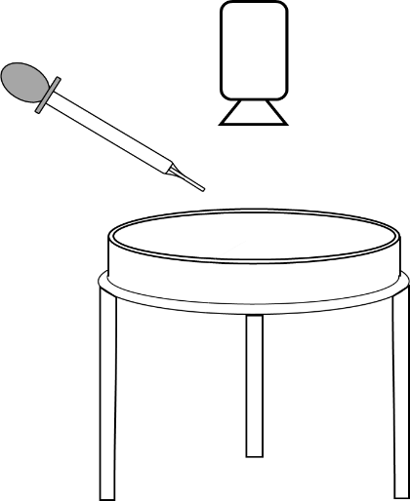
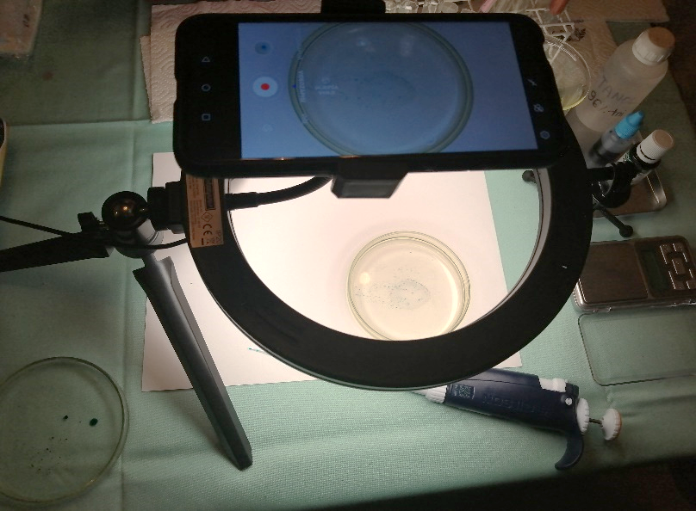
Experiment setup
IYPT 2022 Droplet Explosion – Experiment Setup 15

Slide 16
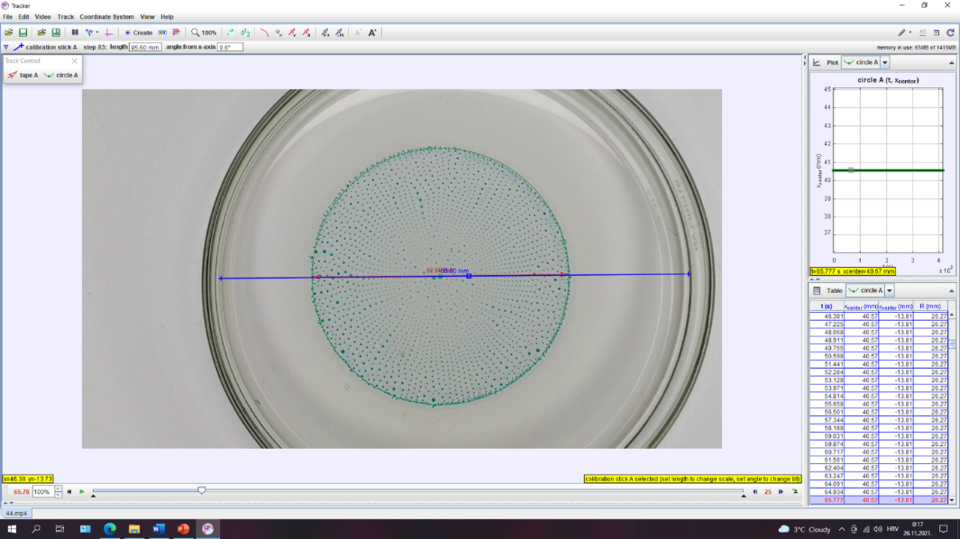
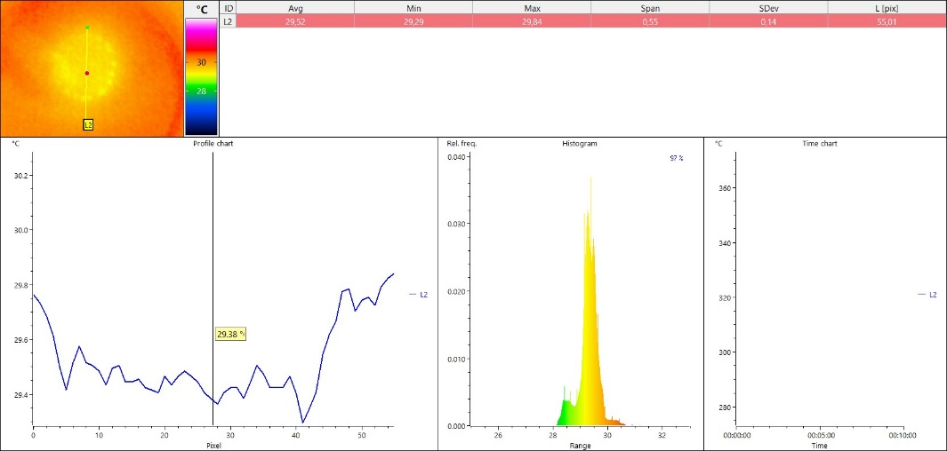
Methodology
IYPT 2022 Droplet Explosion – Experiment Setup 16

Slide 17
Measurements
Experimental measurements:
Droplet expansion
Maximal droplet radius
Dependancy of droplet numbers on alcohol conc.
Dependancy of droplet area on alcohol conc.
Dependancy of droplet area on initial volume
Fingering analysis
Fragmentation regularity
IYPT 2022 Droplet Explosion – Experiment Setup 17

Slide 18
Table of Contents
Problem Description
Analysis of Results
Conclusions
Theoretical Model
Experiment Setup

Slide 19
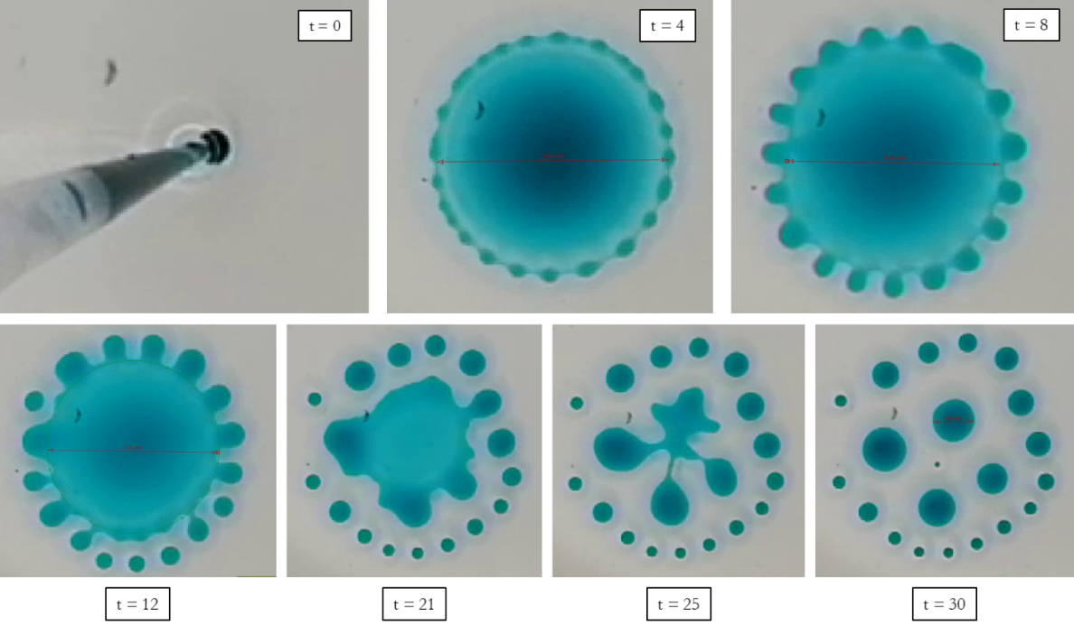
Preliminary observations
IYPT 2022 Droplet Explosion – Analysis of Results 19

Slide 20
Preliminary observations
$$φ=72\%$$
$$φ=80\%$$
$$φ=90\%$$
Alcohol concentration
Existance of phenomenon
Alcohol concentration has
an effect on fragmentation
IYPT 2022 Droplet Explosion – Analysis of Results 20

Slide 21
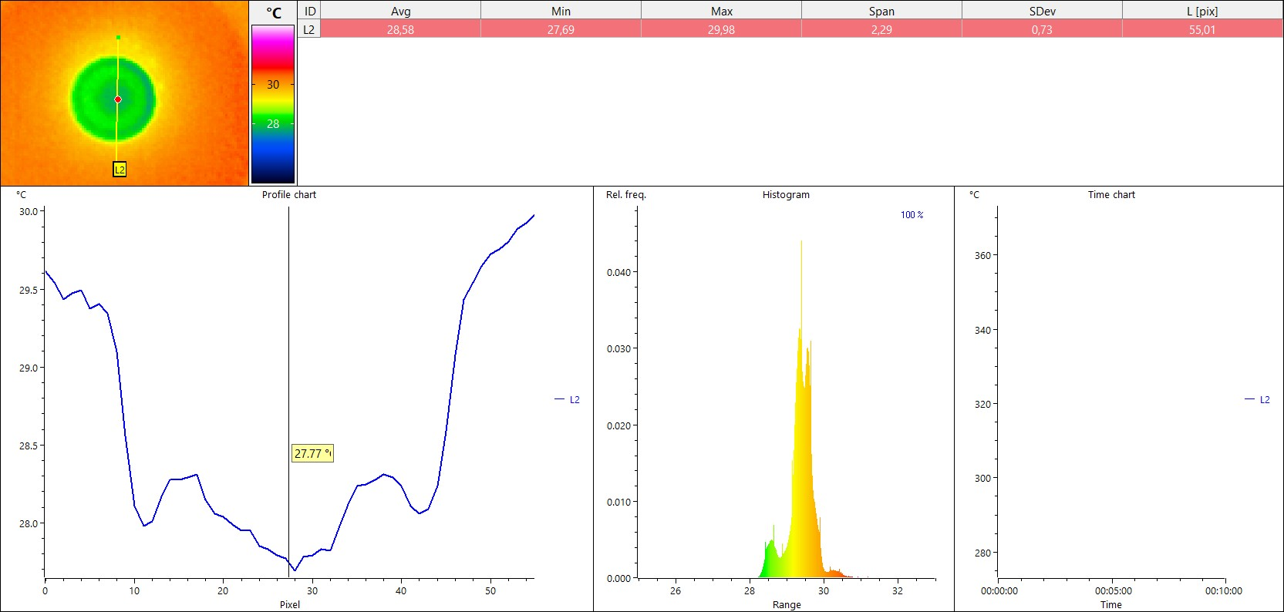
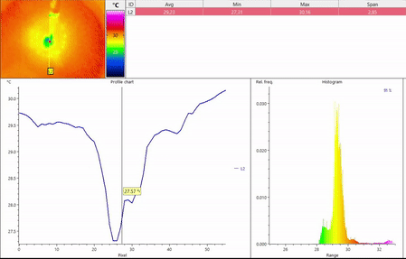
Thermal image
Solutal and thermal gradient
Marangoni stress
IYPT 2022 Droplet Explosion – Analysis of Results 20

Slide 22
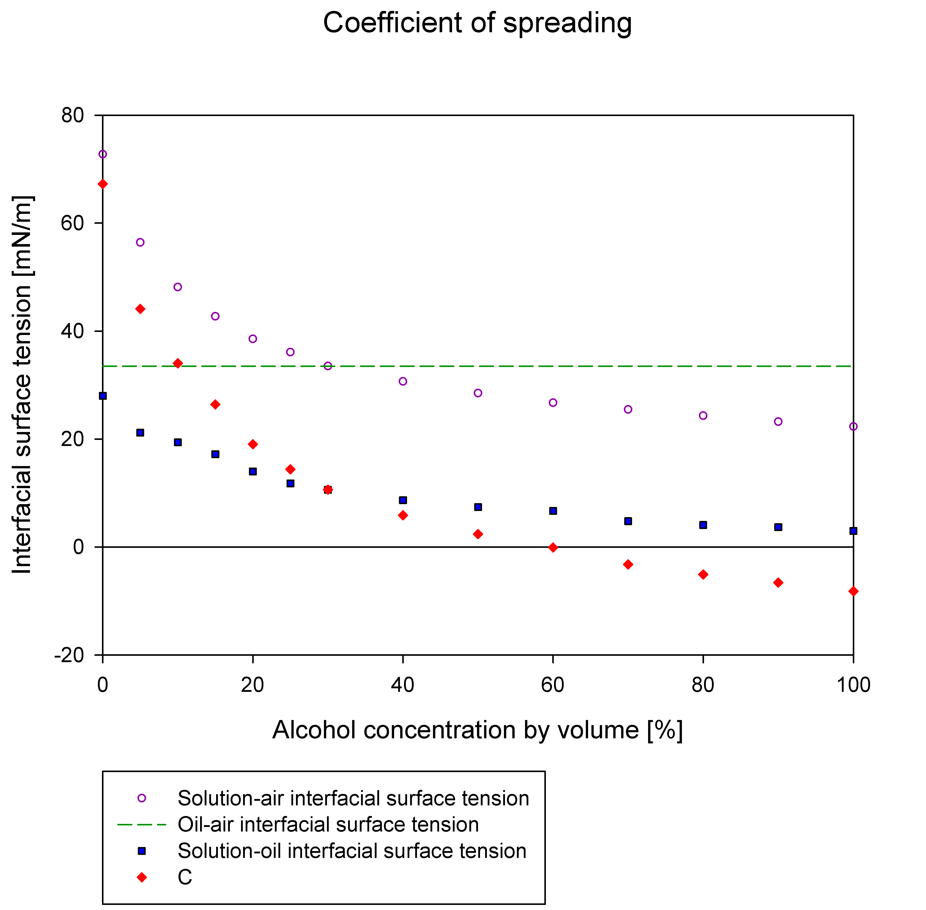
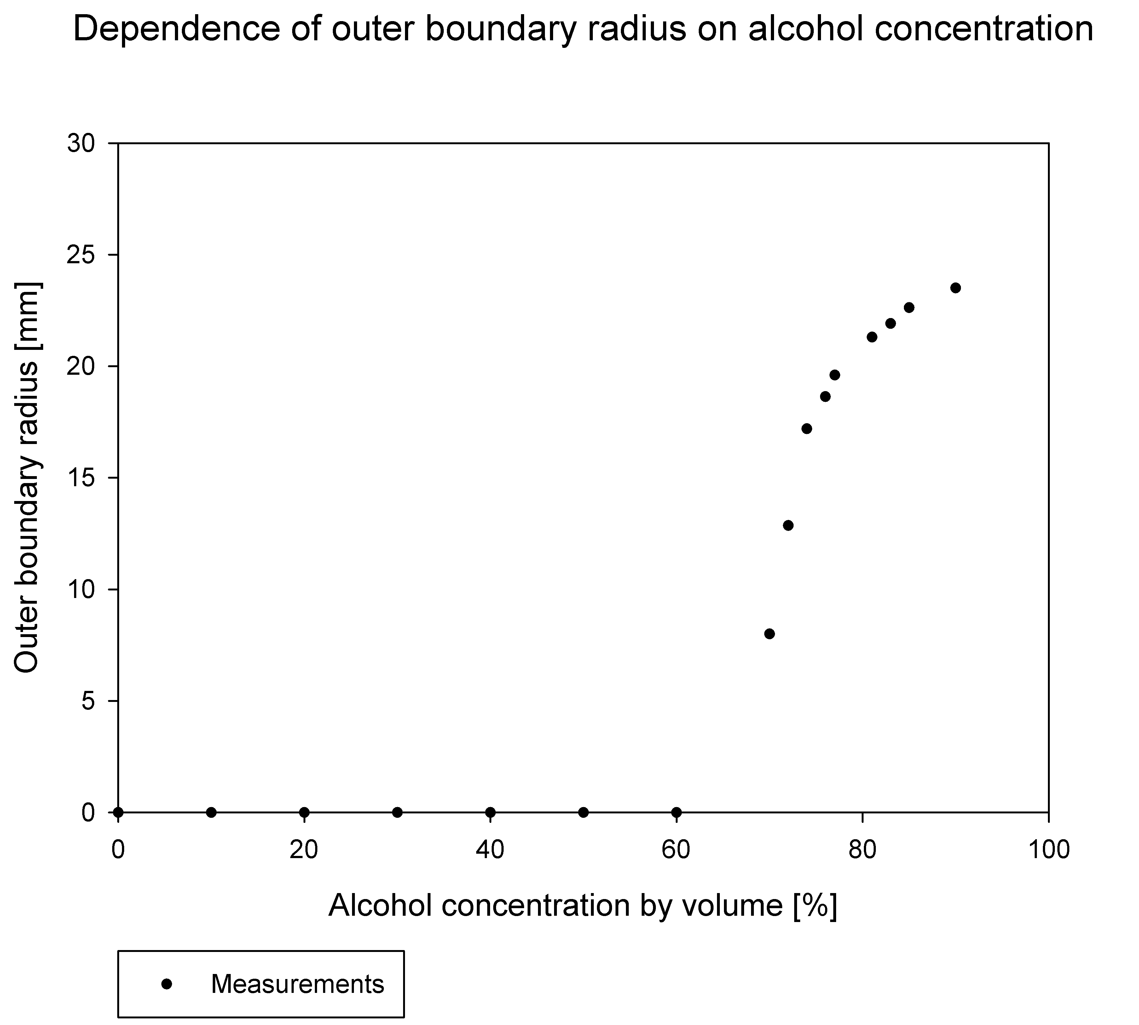
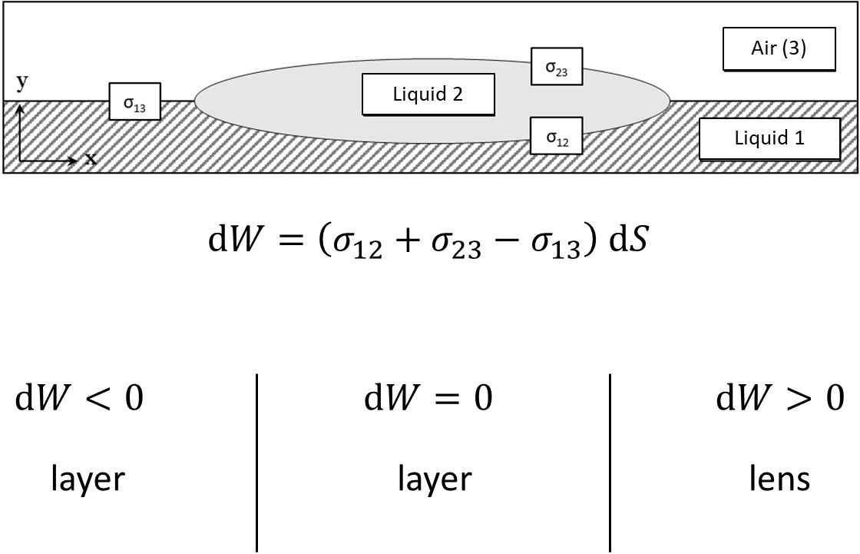
Boundary concentration
$$dW=\left(σ_{12}+σ_{23}−σ_{13}\right) dS$$
$$σ_{oil−solution}+σ_{solution}−σ_{oil}<0$$
$$C=σ_{oil−solution}+σ_{solution}−σ_{oil}$$
IYPT 2022 Droplet Explosion – Analysis of Results 20

Slide 23
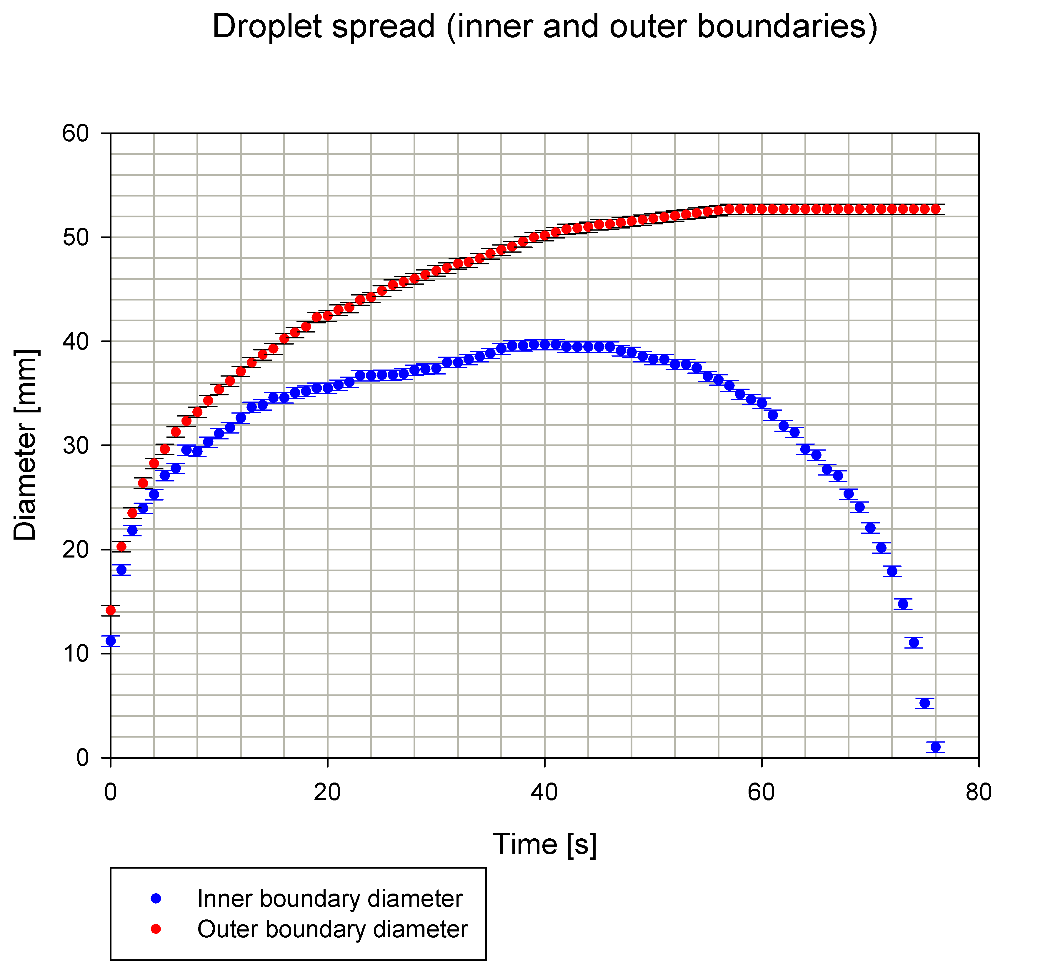
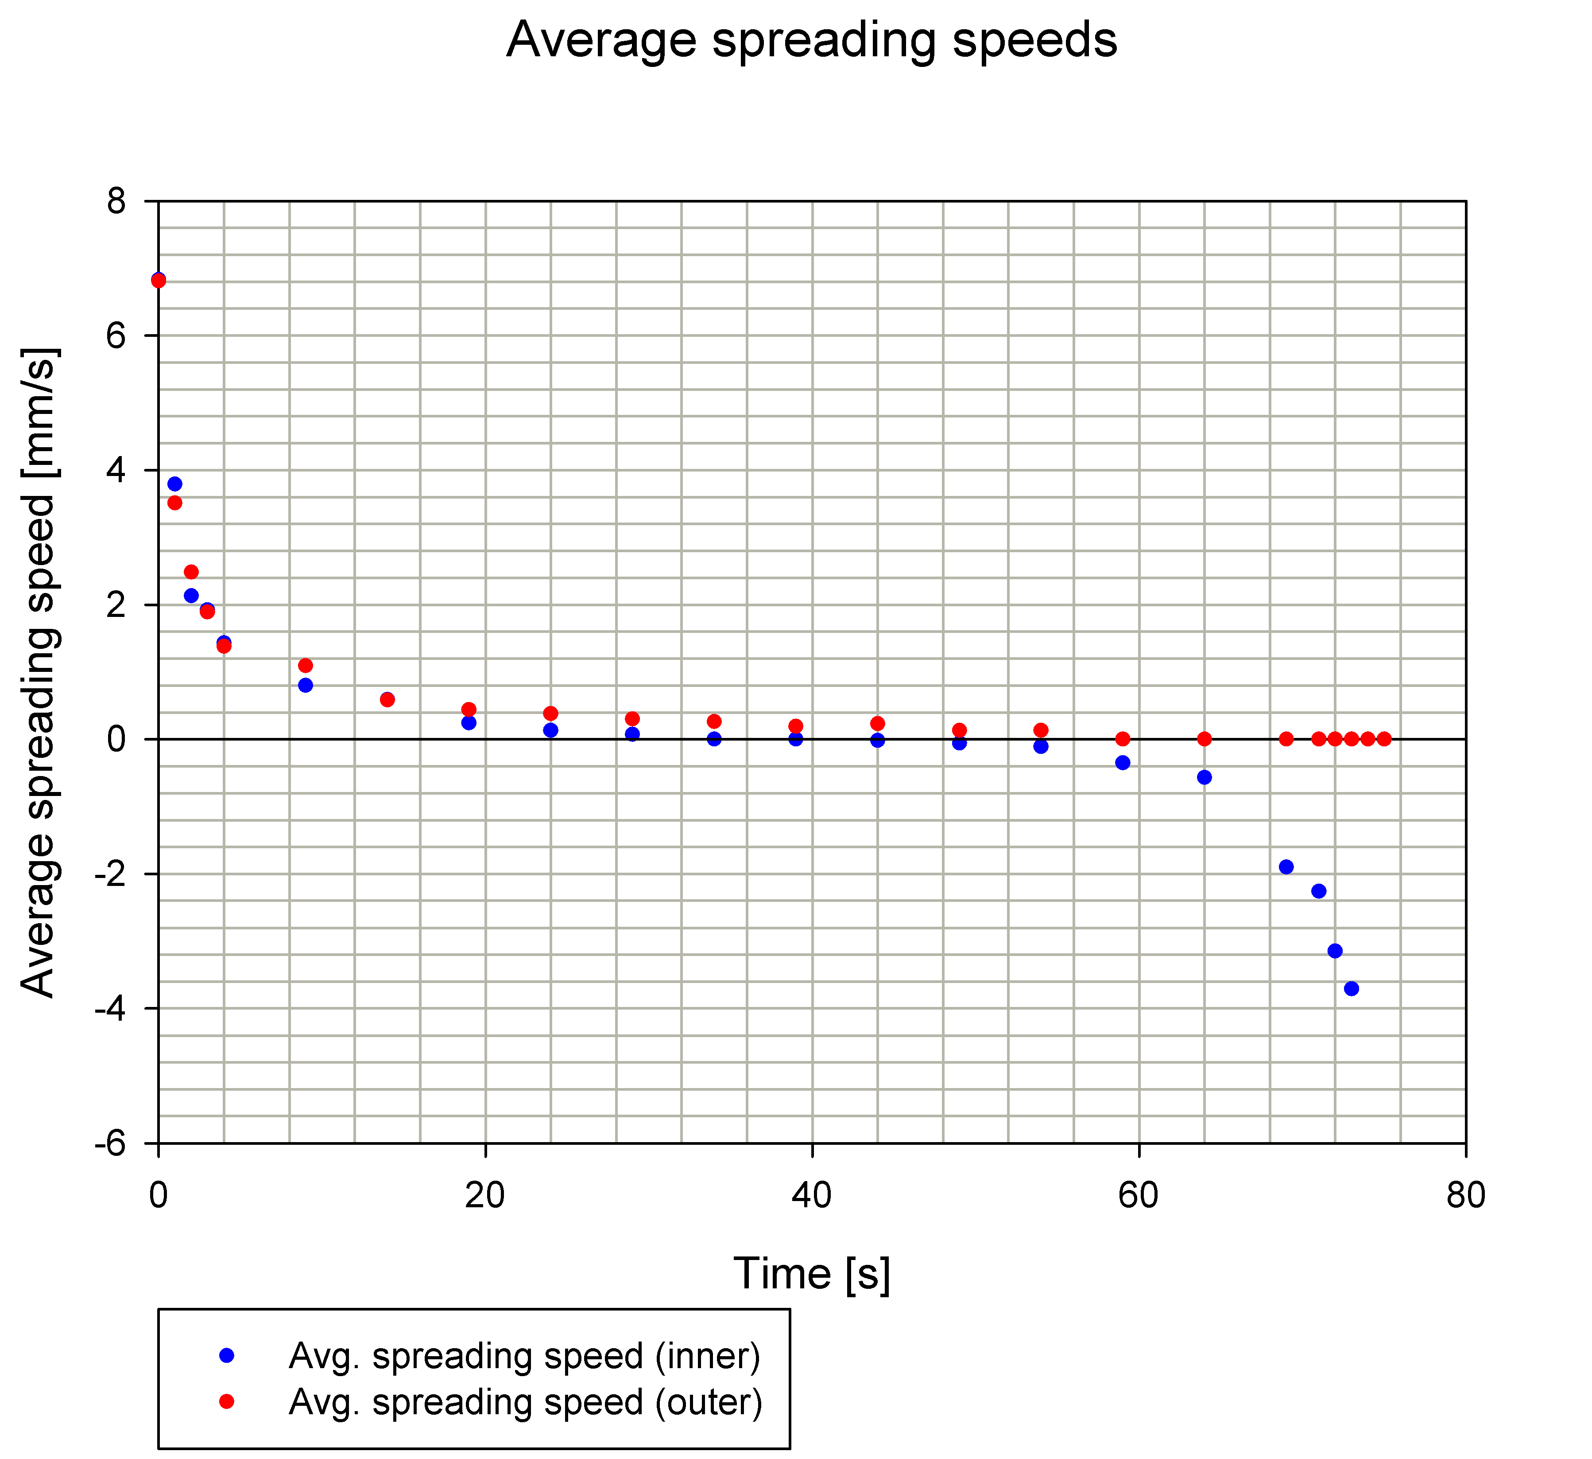
Droplet spreading ($φ_{0}=90\%)$
IYPT 2022 Droplet Explosion – Analysis of Results 21

Slide 24
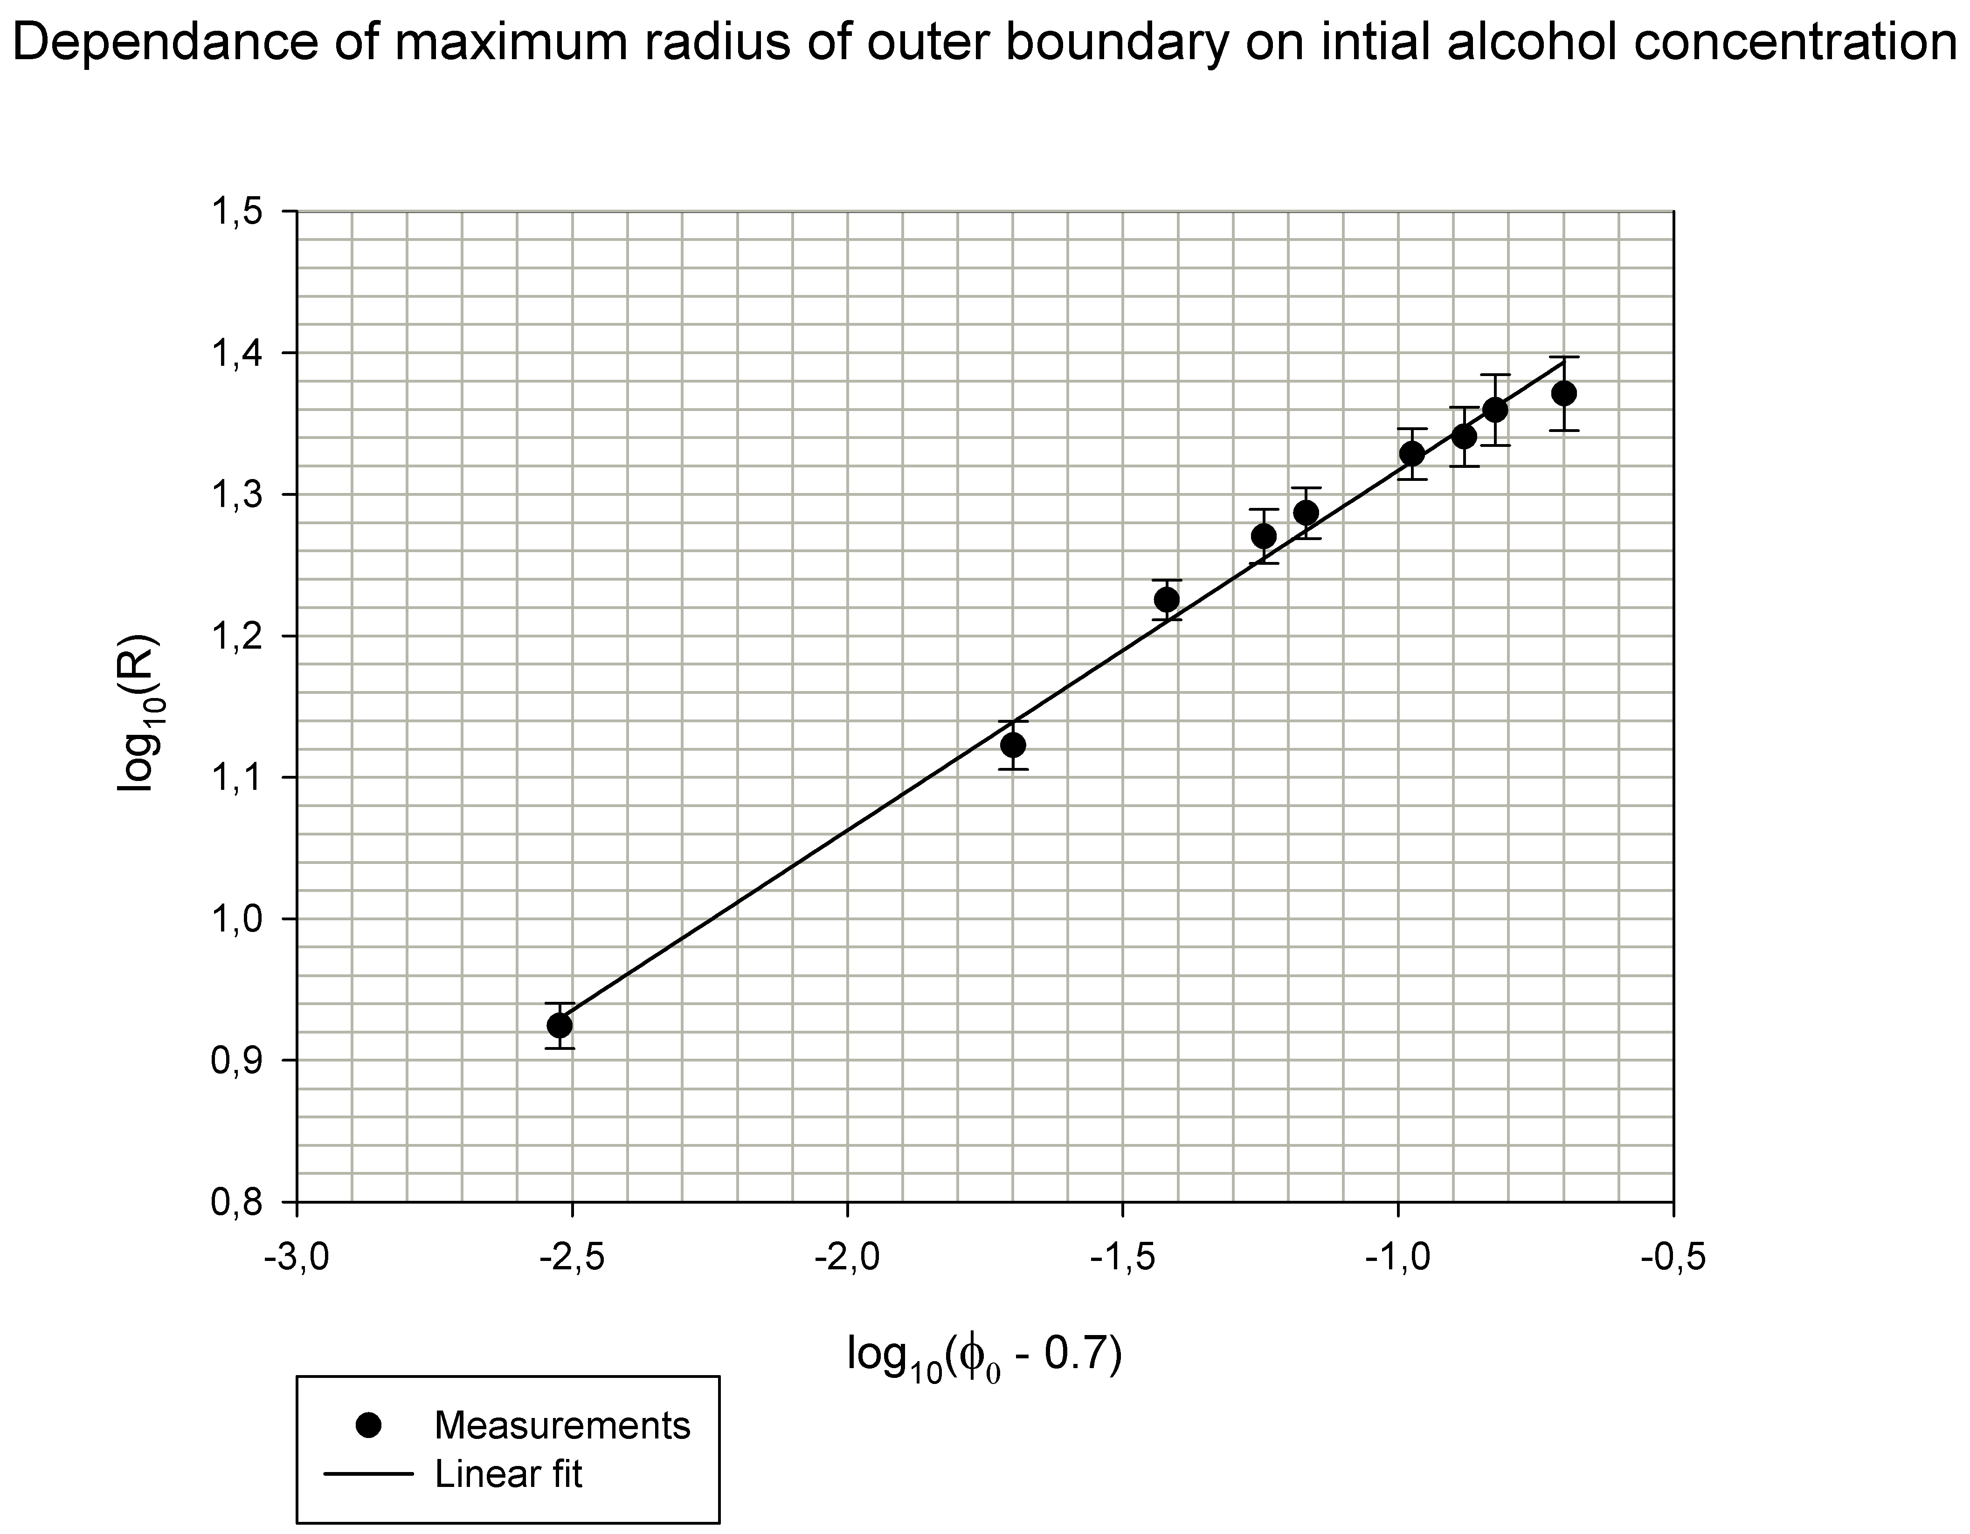
$$R_{max} \sim φ_{al.}$$
$$R_{max} \sim a{\left[\frac{\left(Φ_{0}−Φ_{c}\right)∆γHΩ_{0}}{\left(1−Φ_{c}\right)μ_{0}j_{v}}\right]}^{\frac{1}{4}}$$
$$R_{max} \sim a{\left[\frac{\left(Φ_{0}−0.7\right)}{\left(1−0.7\right)}\right]}^{\frac{1}{4}}$$
$$y=0,2543x+1,5711$$
$$\log_{10}\left(R_{max}\right)=\log_{10}\left(a\right)+\frac{1}{4}\log_{10}\left(φ_{0}−0.7\right)$$
$$y{=\frac{1}{4}\left(φ_{0}−0.7\right)+l}$$
IYPT 2022 Droplet Explosion – Analysis of Results 22

Slide 25
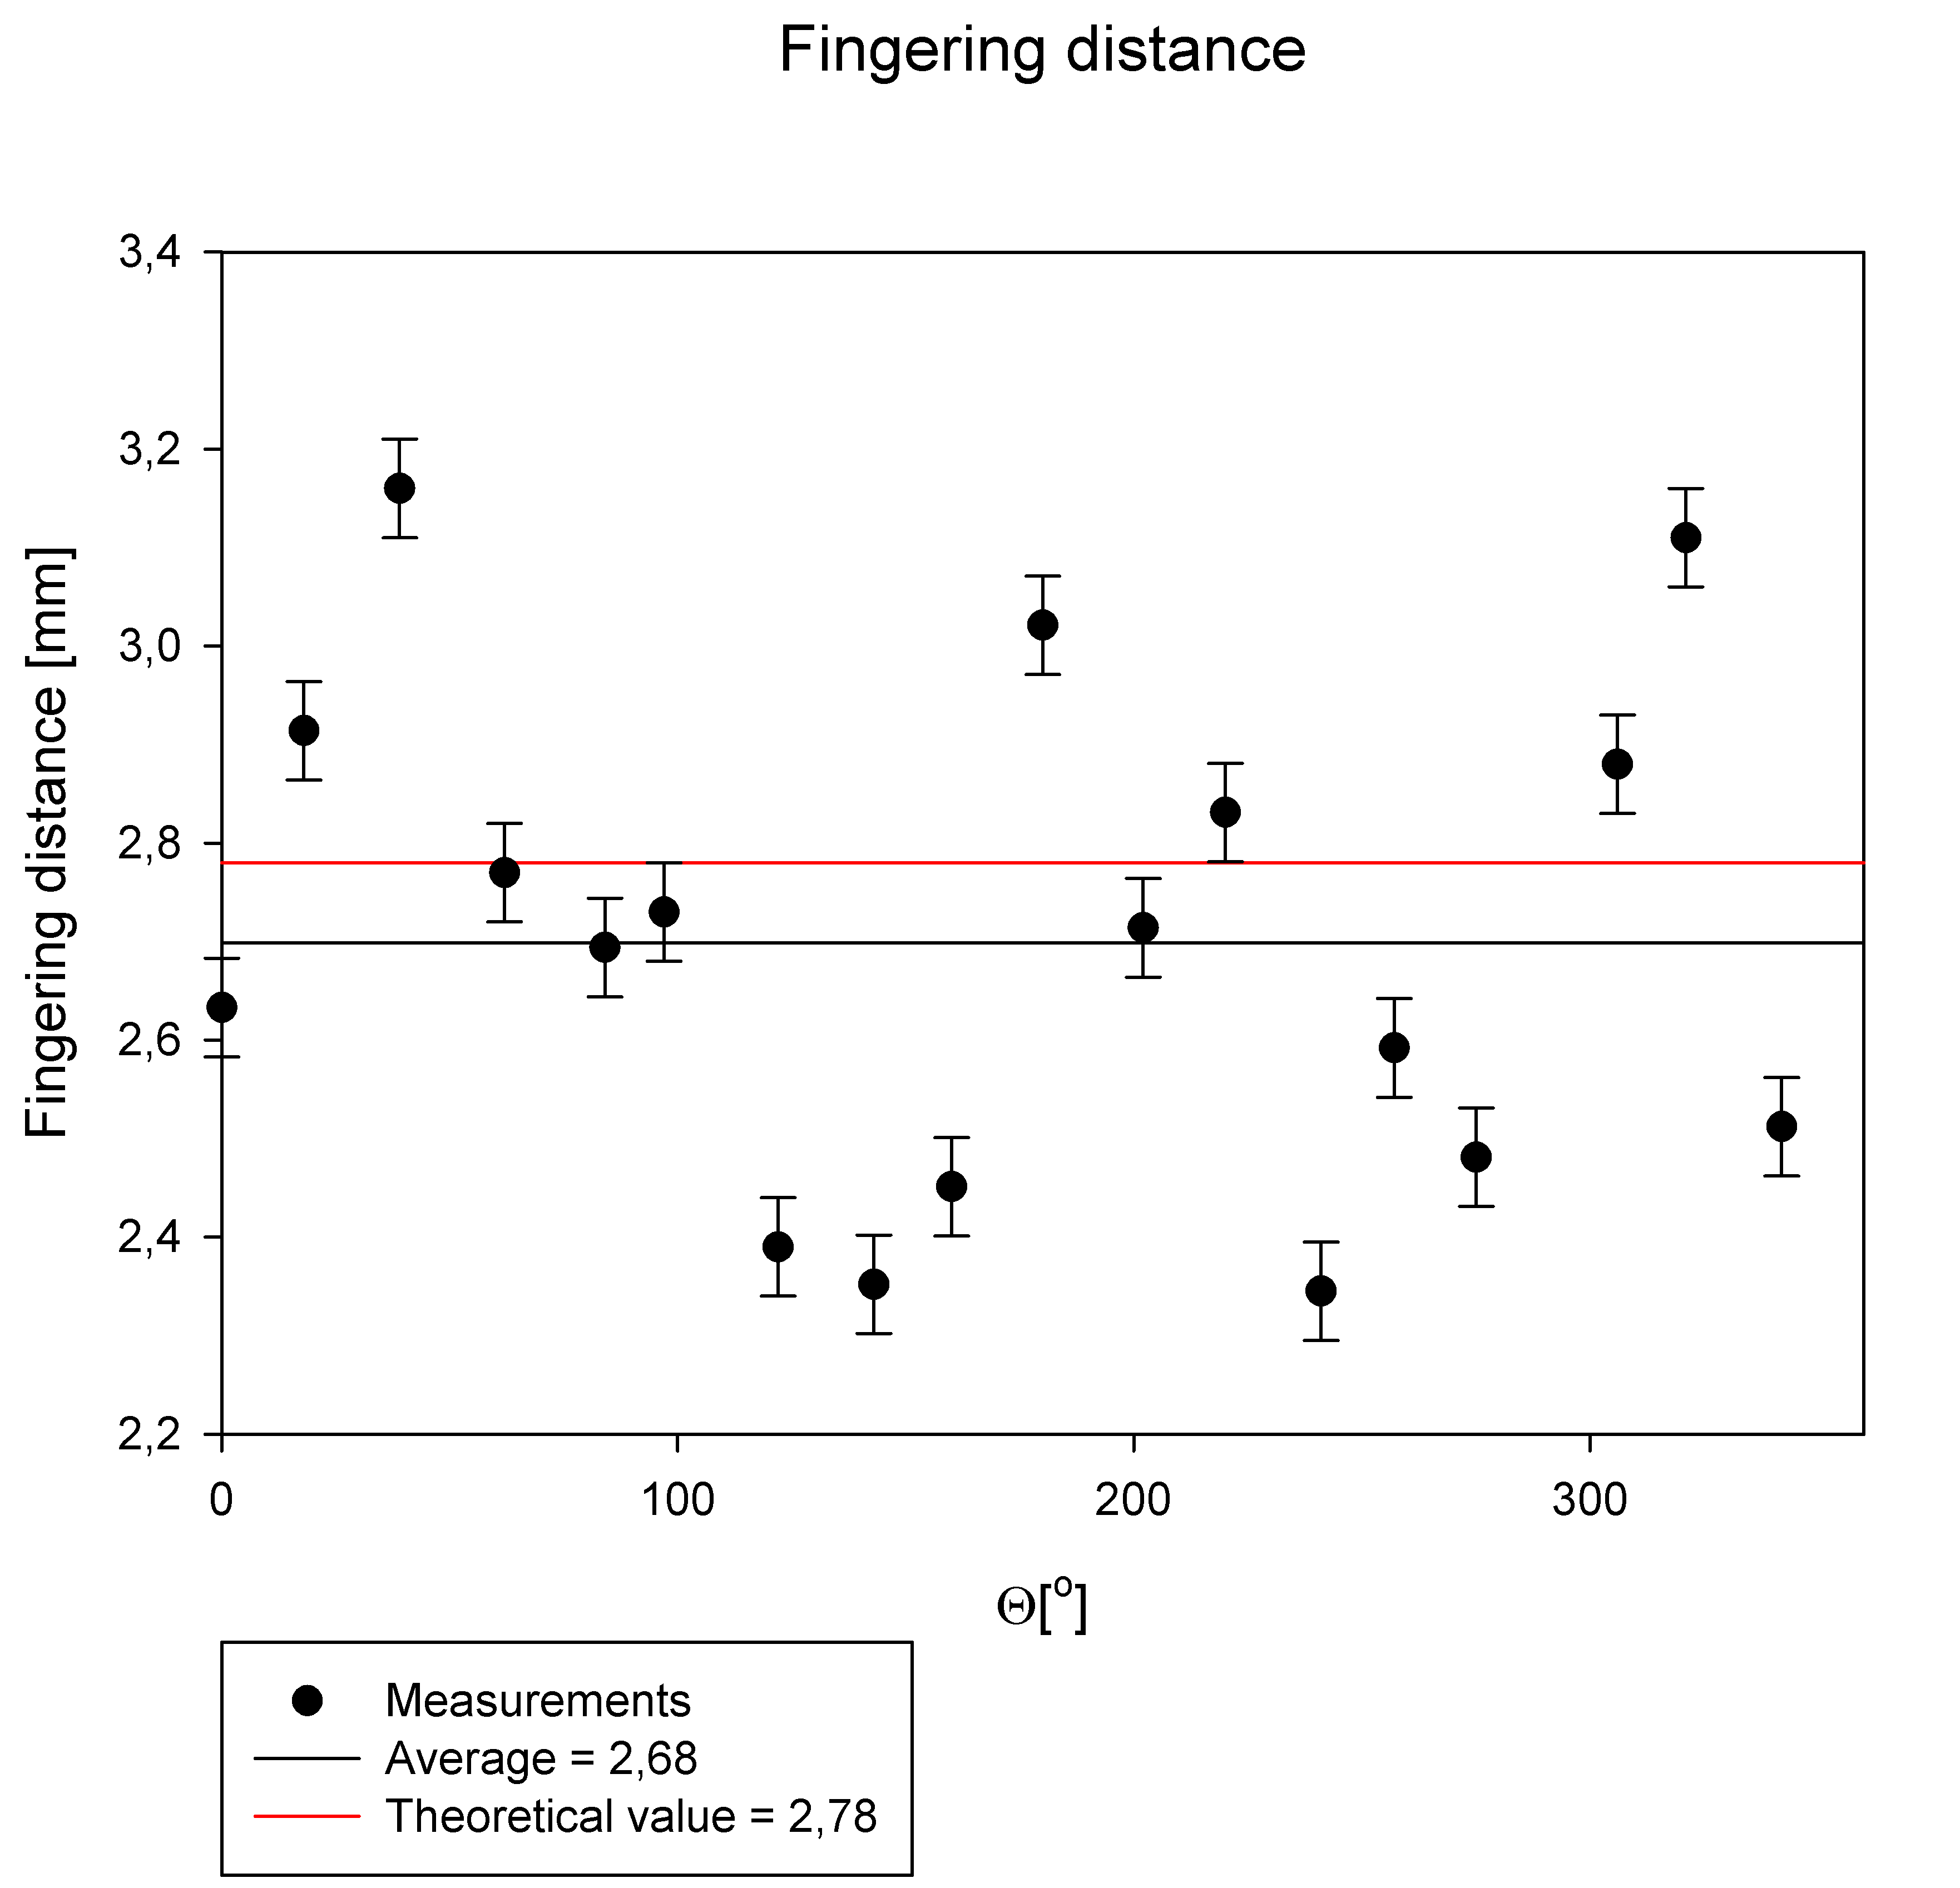
Fingering wavelength ($φ_{0}=70\%)$
$$l_{c}=\sqrt{\frac{σ}{\left(ρ_{o}−ρ_{s}\right)g}}$$
$$2l_{c}$$
$$θ$$
IYPT 2022 Droplet Explosion – Analysis of Results 24

Slide 26
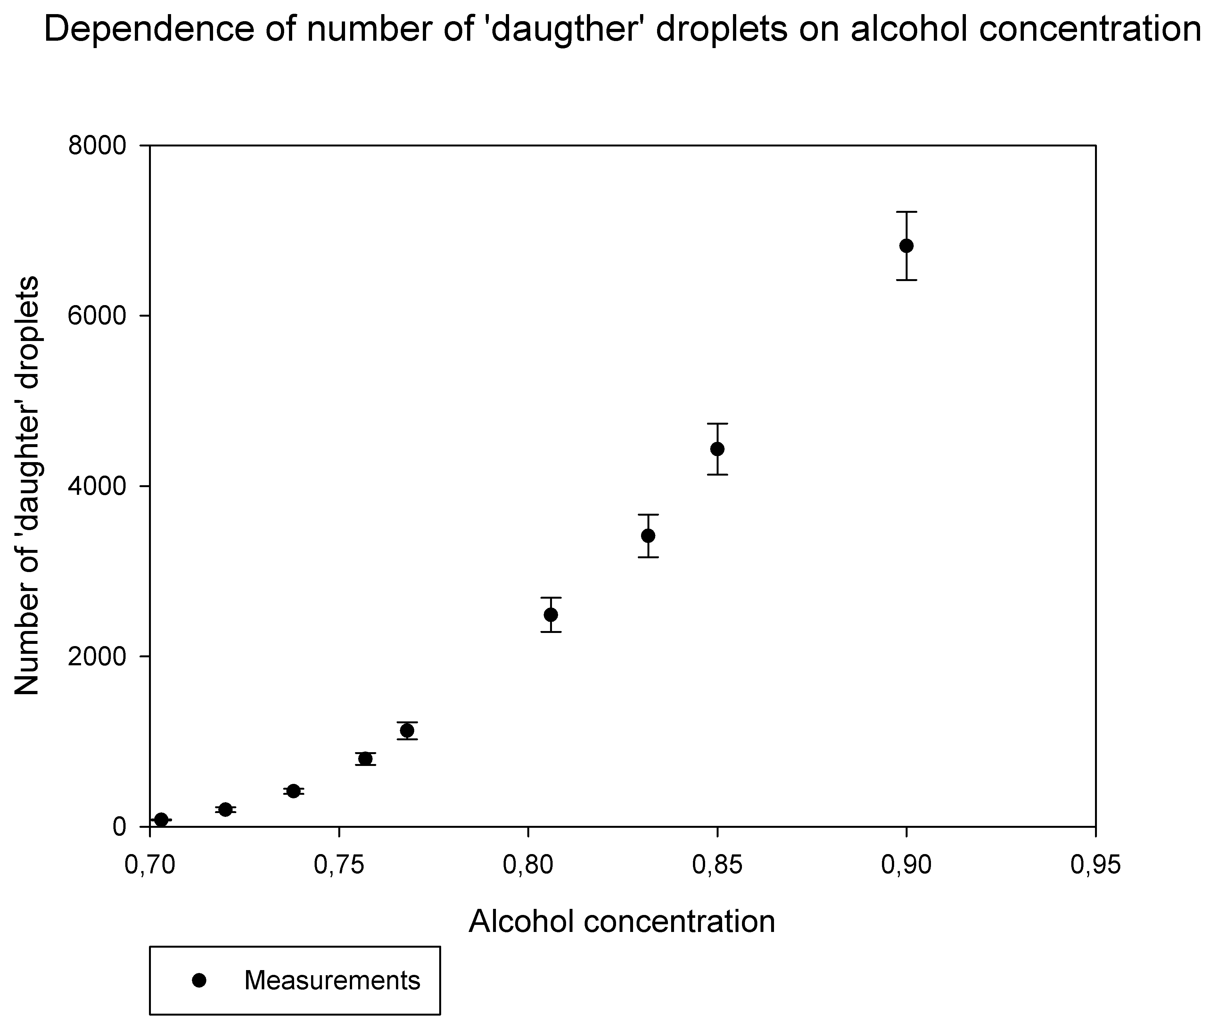
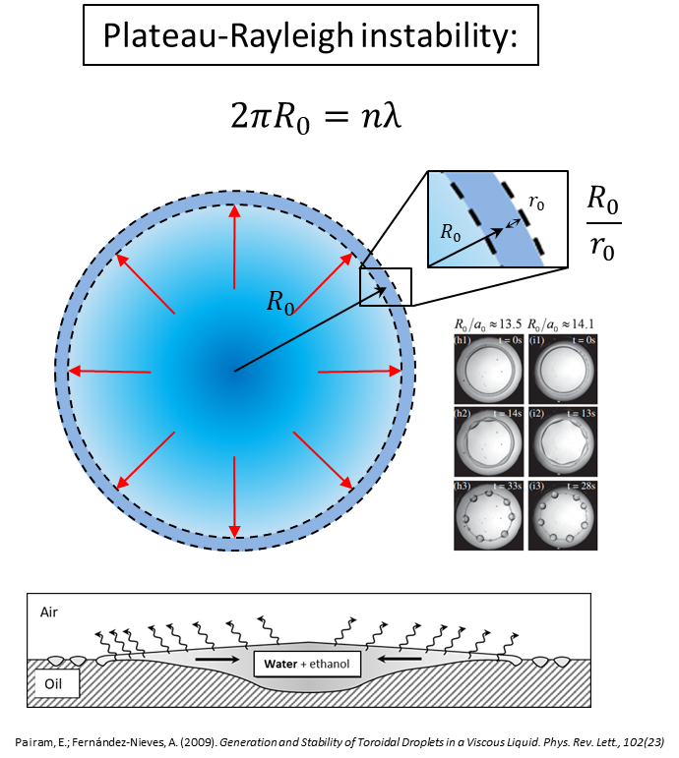
Number of ‘daughter’ droplets
$$γ_{sol.}≈26.48 mN/m$$
$$γ_{sol.}≈24.23 mN/m$$
$$l_{c}=\sqrt{\frac{σ}{\left(ρ_{o}−ρ_{s}\right)g}}$$
IYPT 2022 Droplet Explosion – Analysis of Results 23

Slide 27
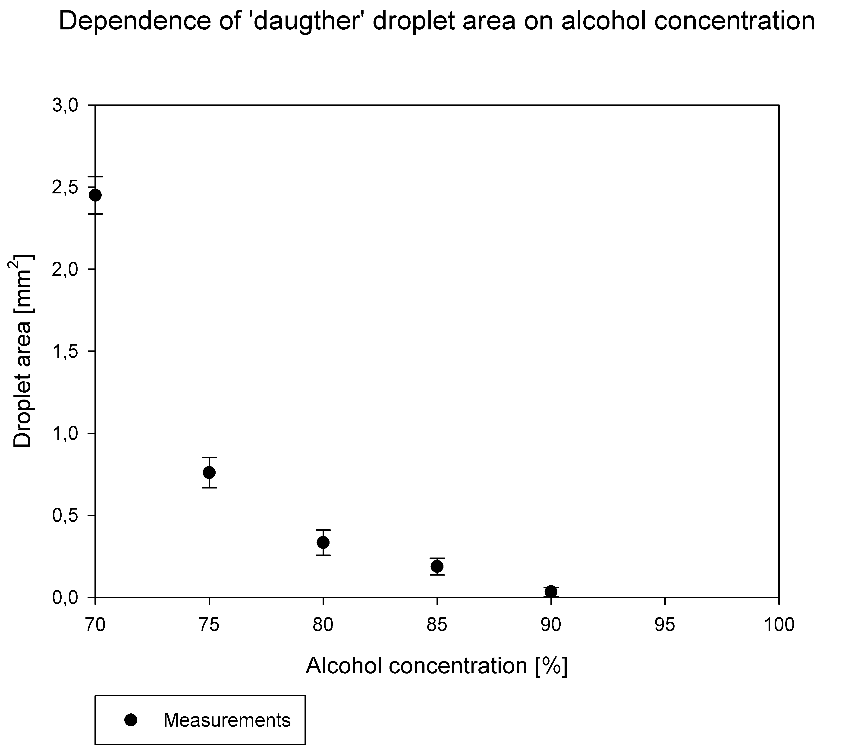
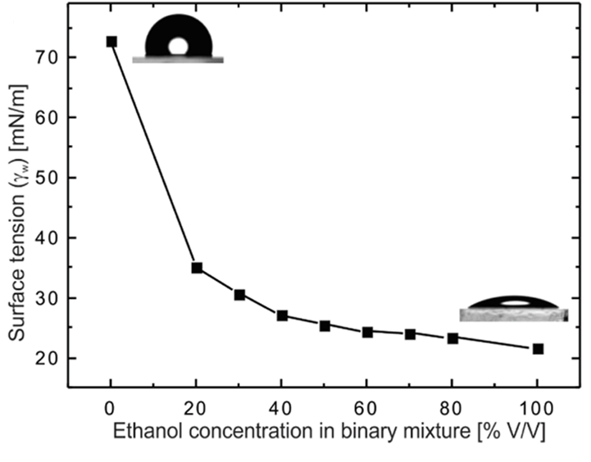
‘Daughter’ droplet area
$$∆p=\frac{σ}{R}$$
IYPT 2022 Droplet Explosion – Analysis of Results 26

Slide 28
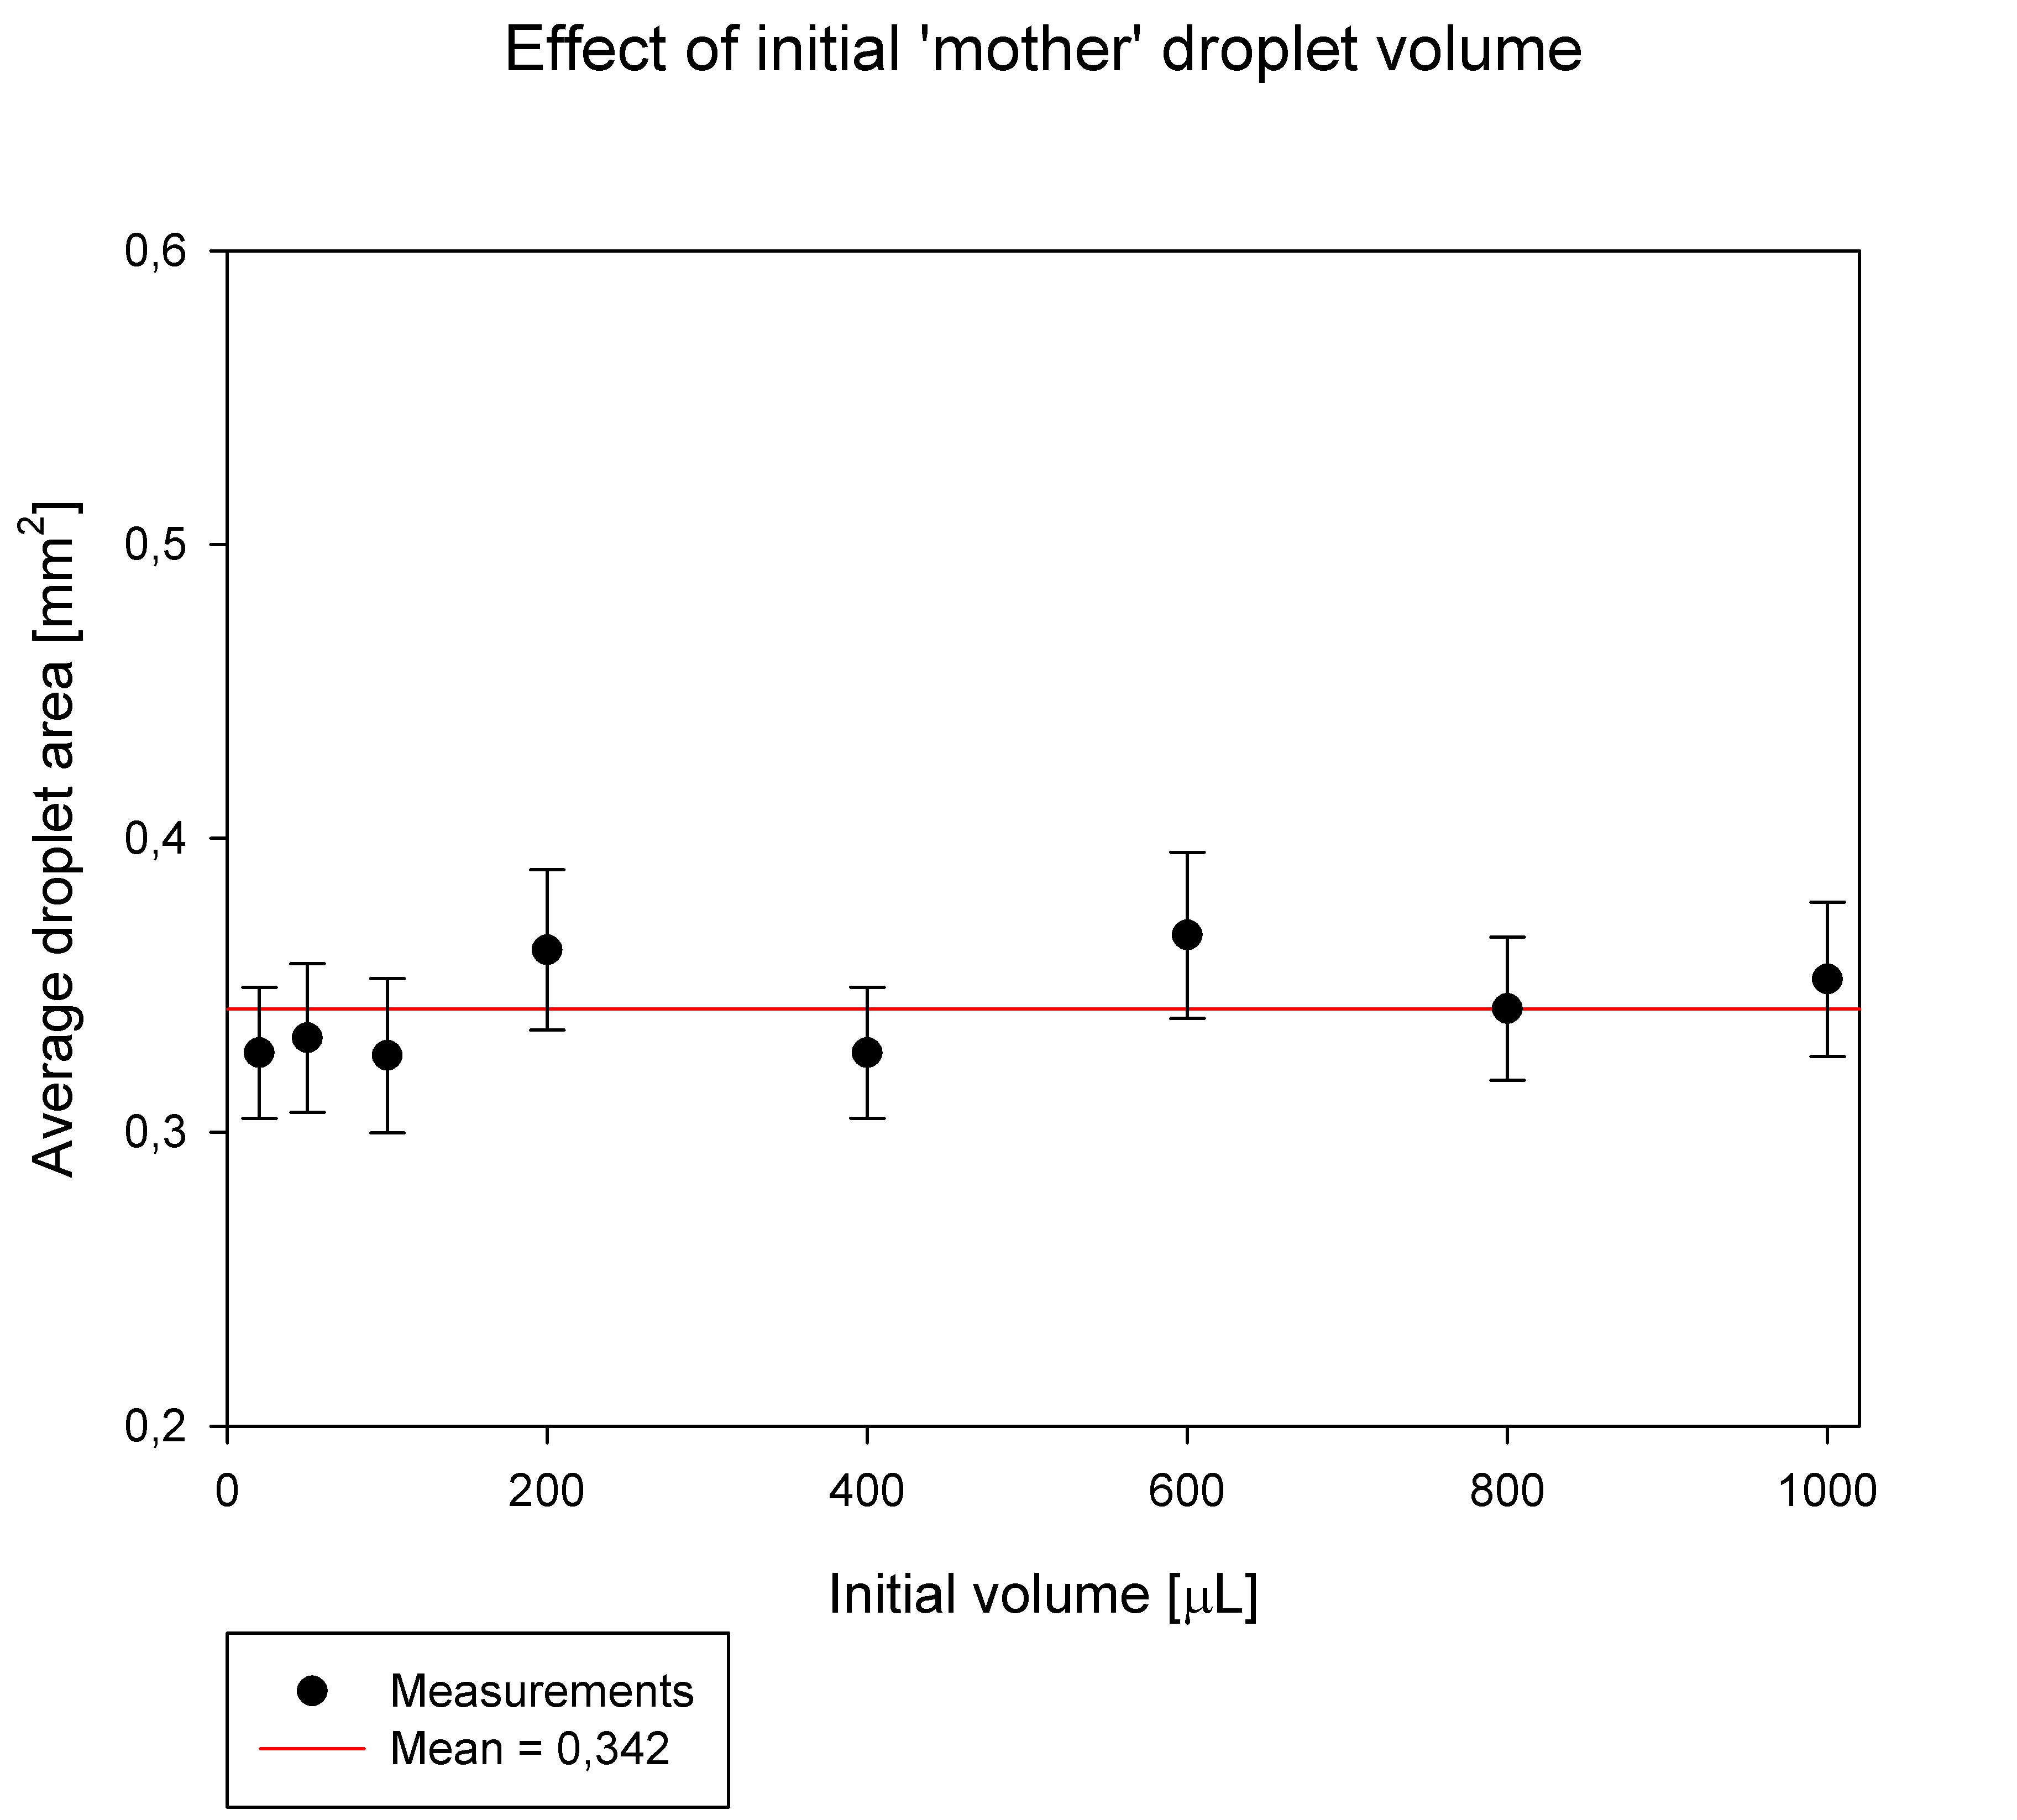
‘Daughter’ droplet area
IYPT 2022 Droplet Explosion – Analysis of Results 27

Slide 29
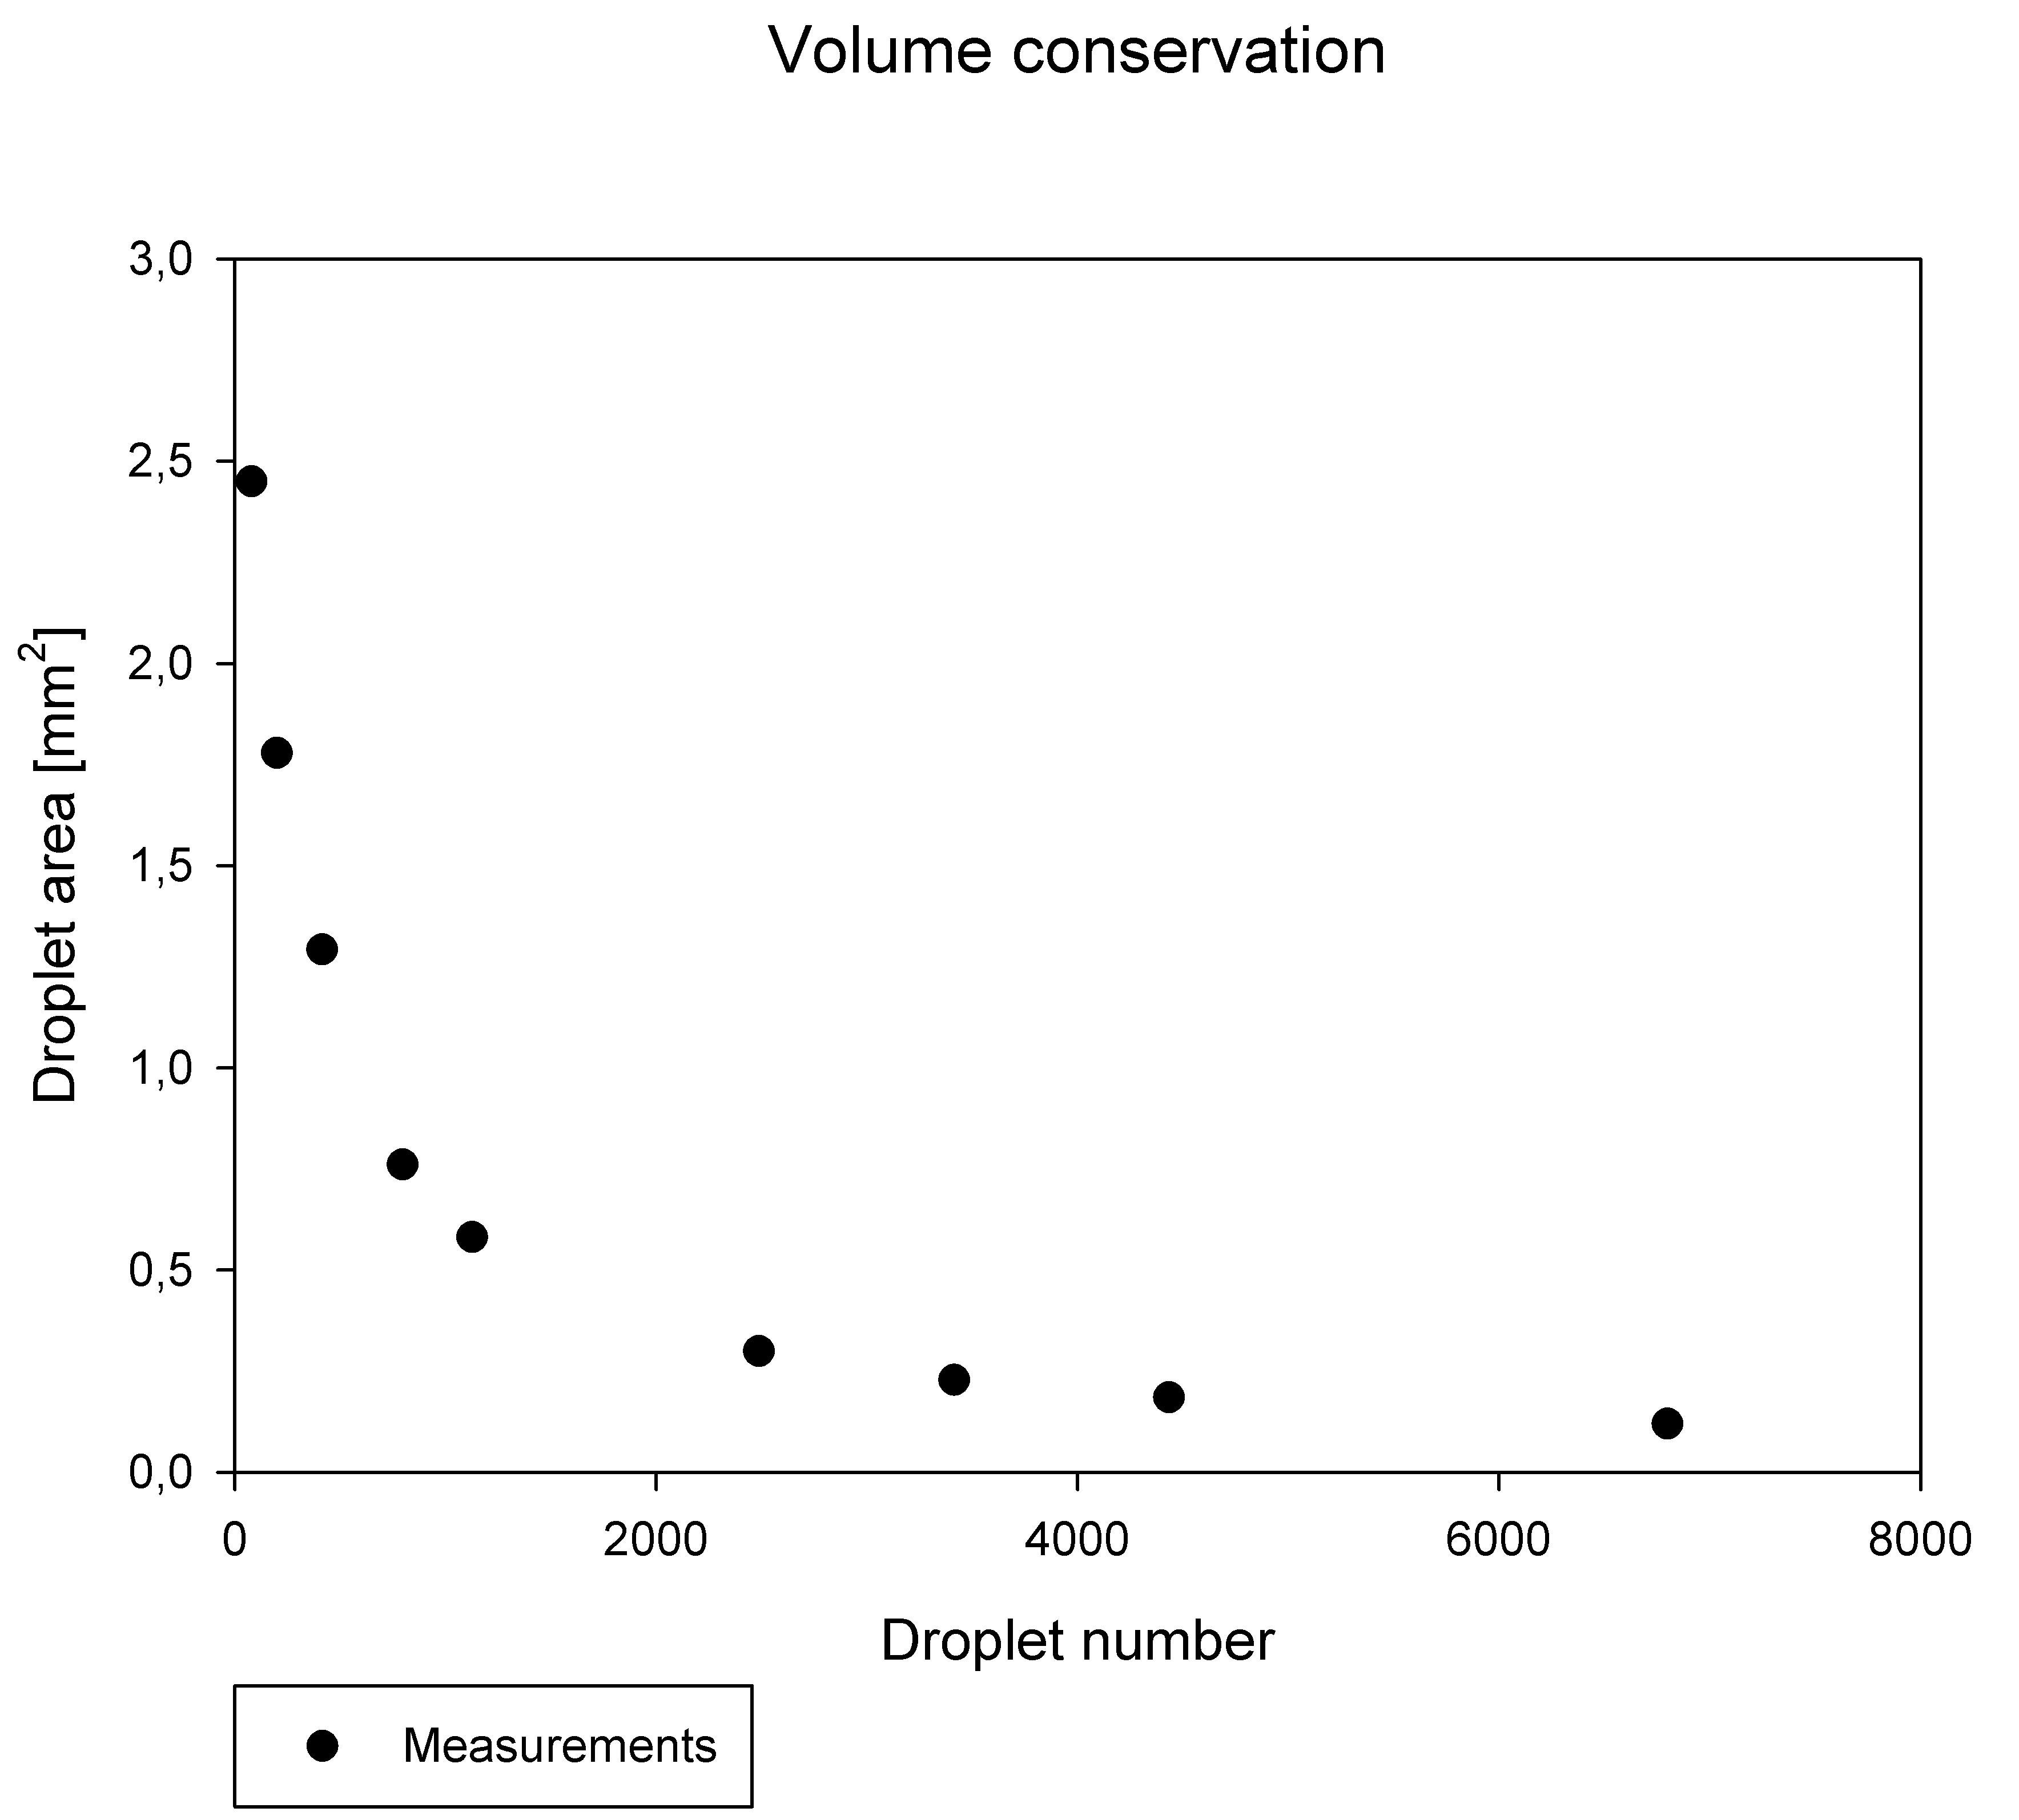
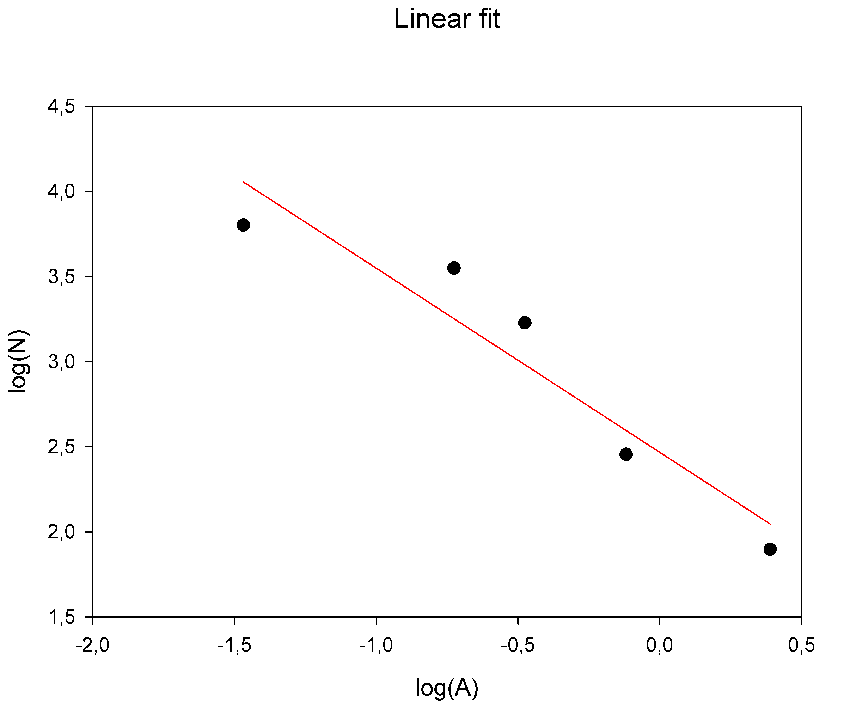
Number and area
$$V_{0}=N∙A∙h$$
$$N \sim { A}^{−1}$$
$$y=−1,082x+2,466$$
$$R^{2}=0,8986$$
IYPT 2022 Droplet Explosion – Analysis of Results 27

Slide 30
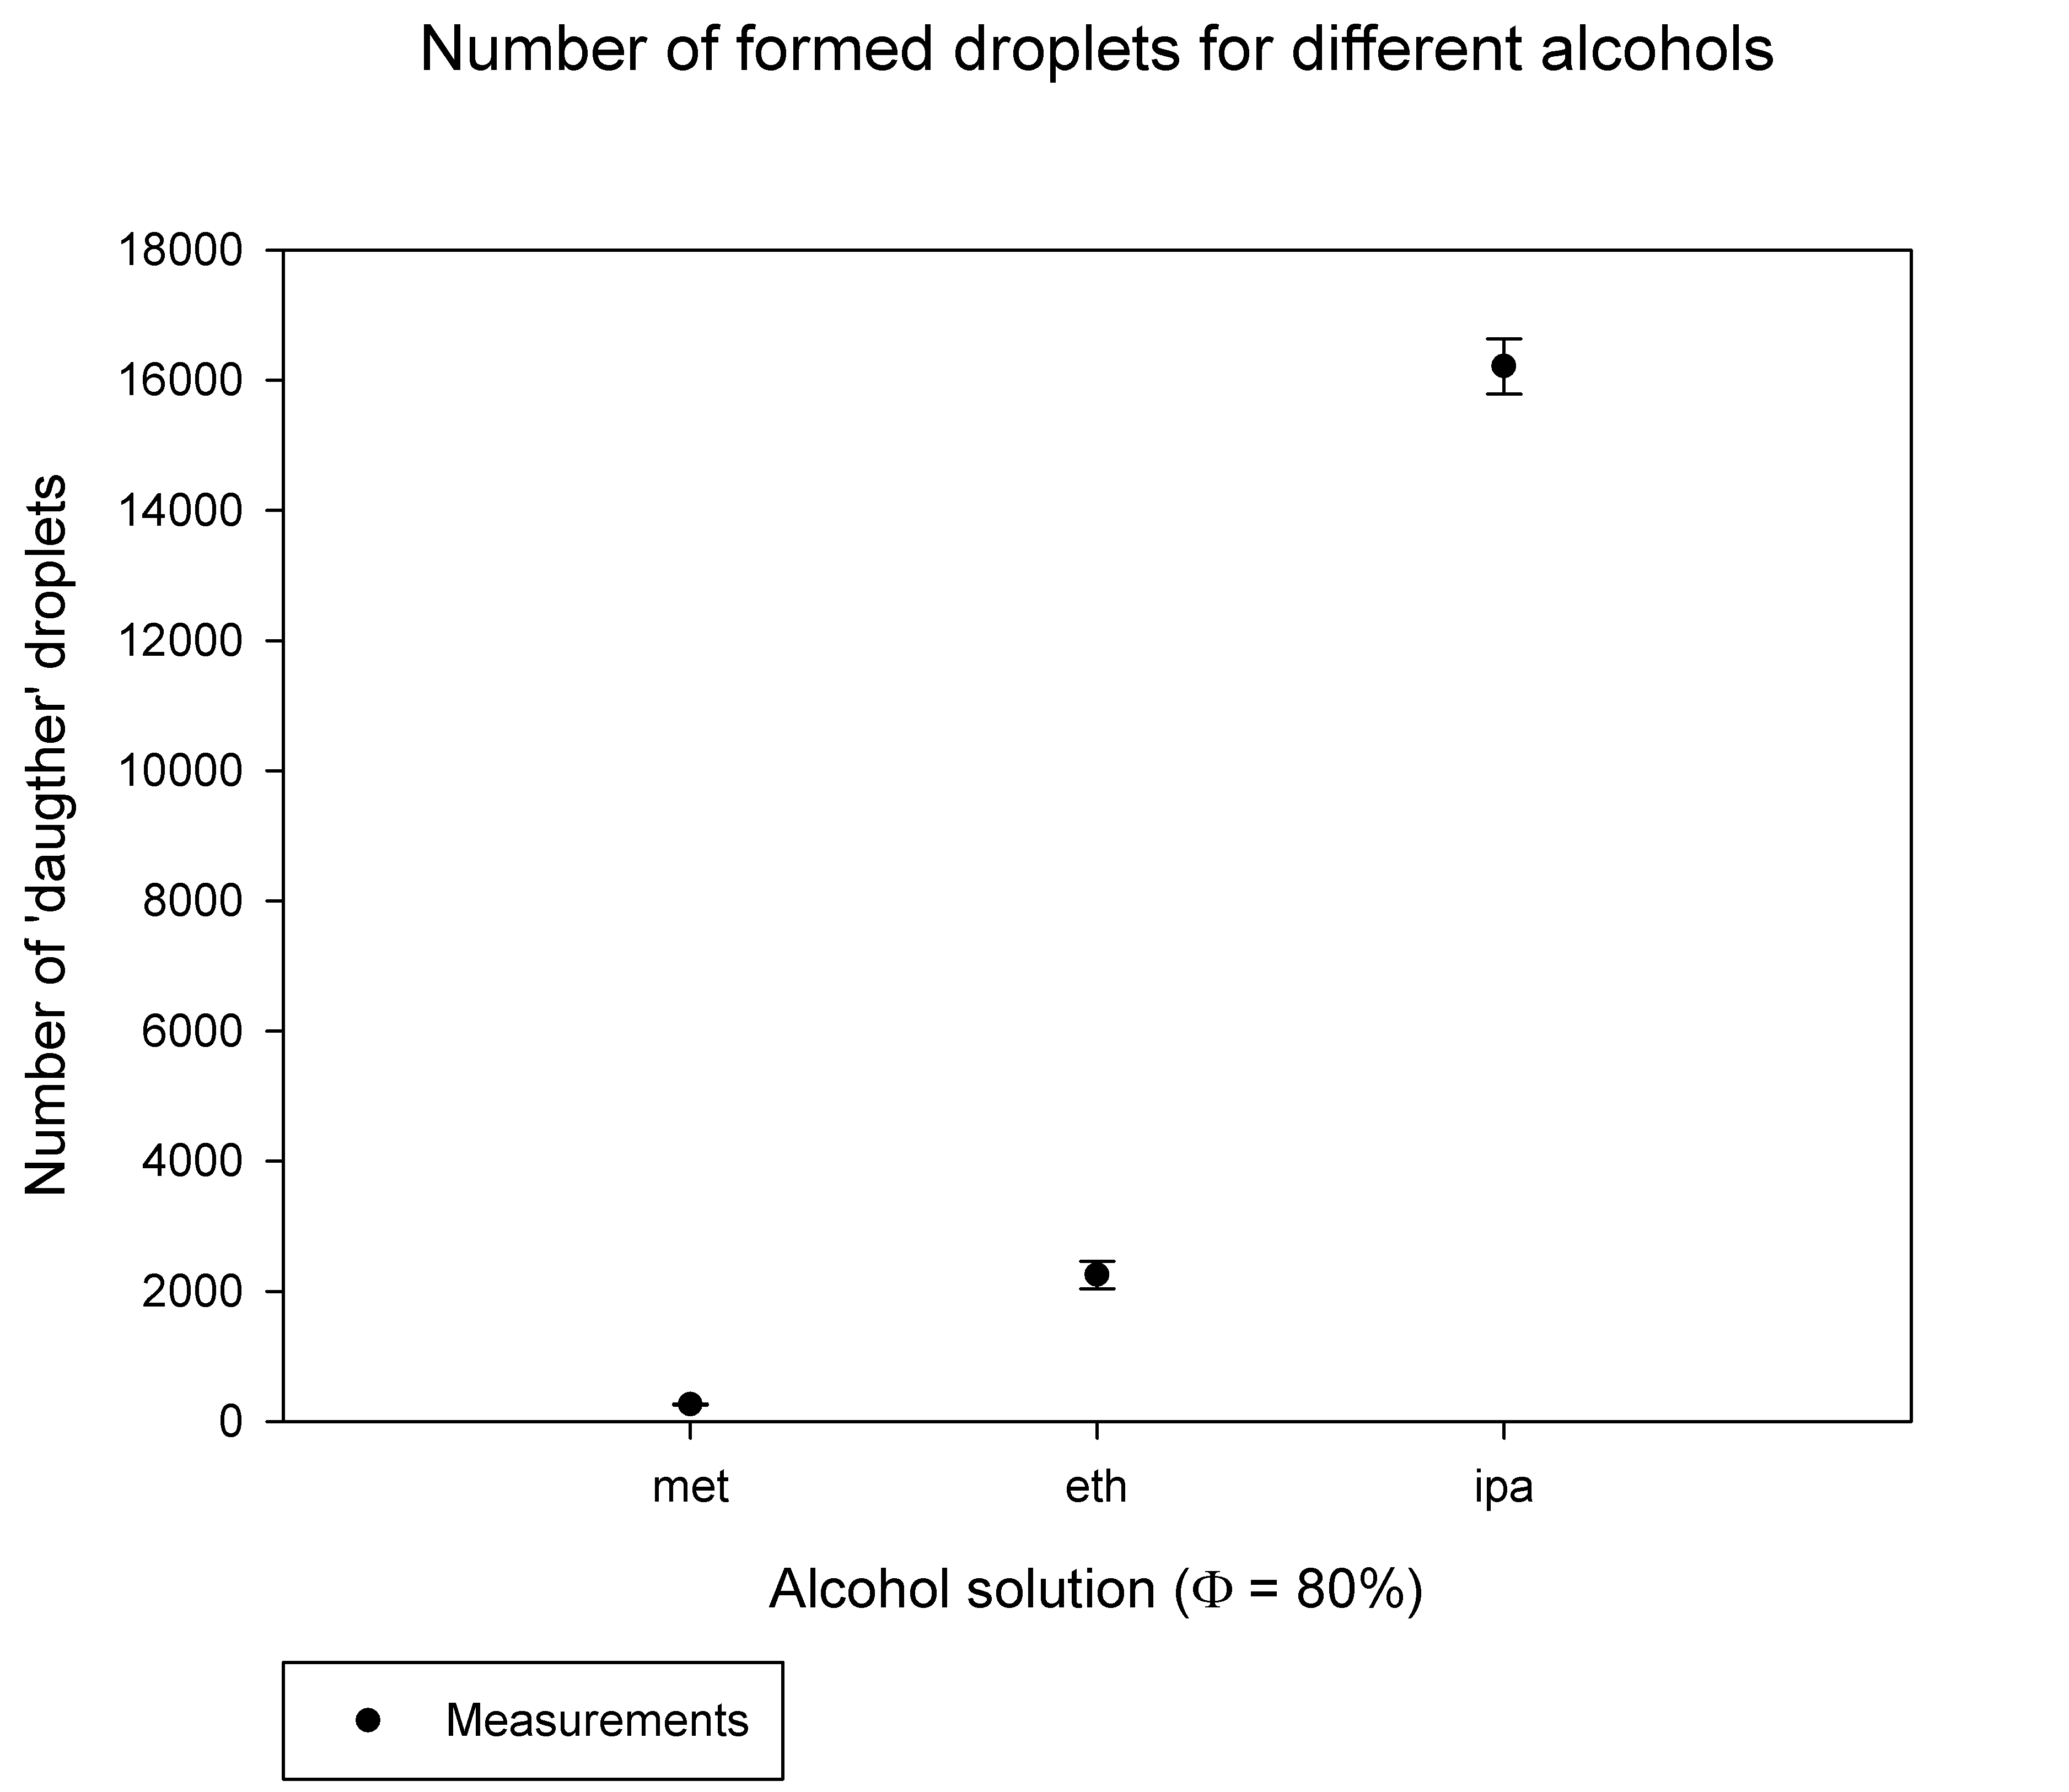
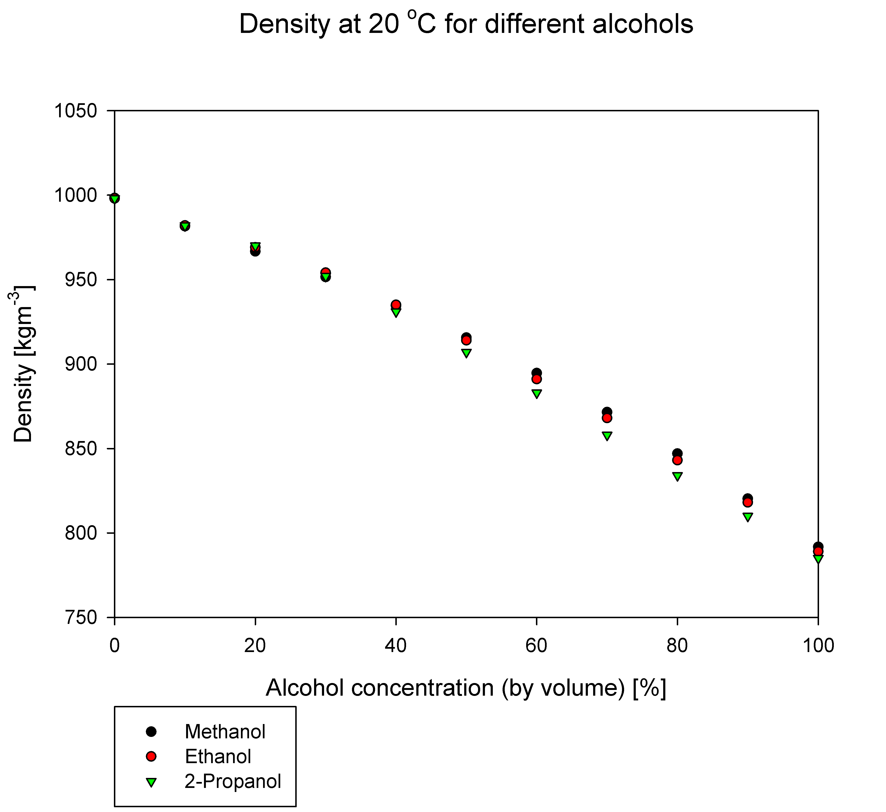
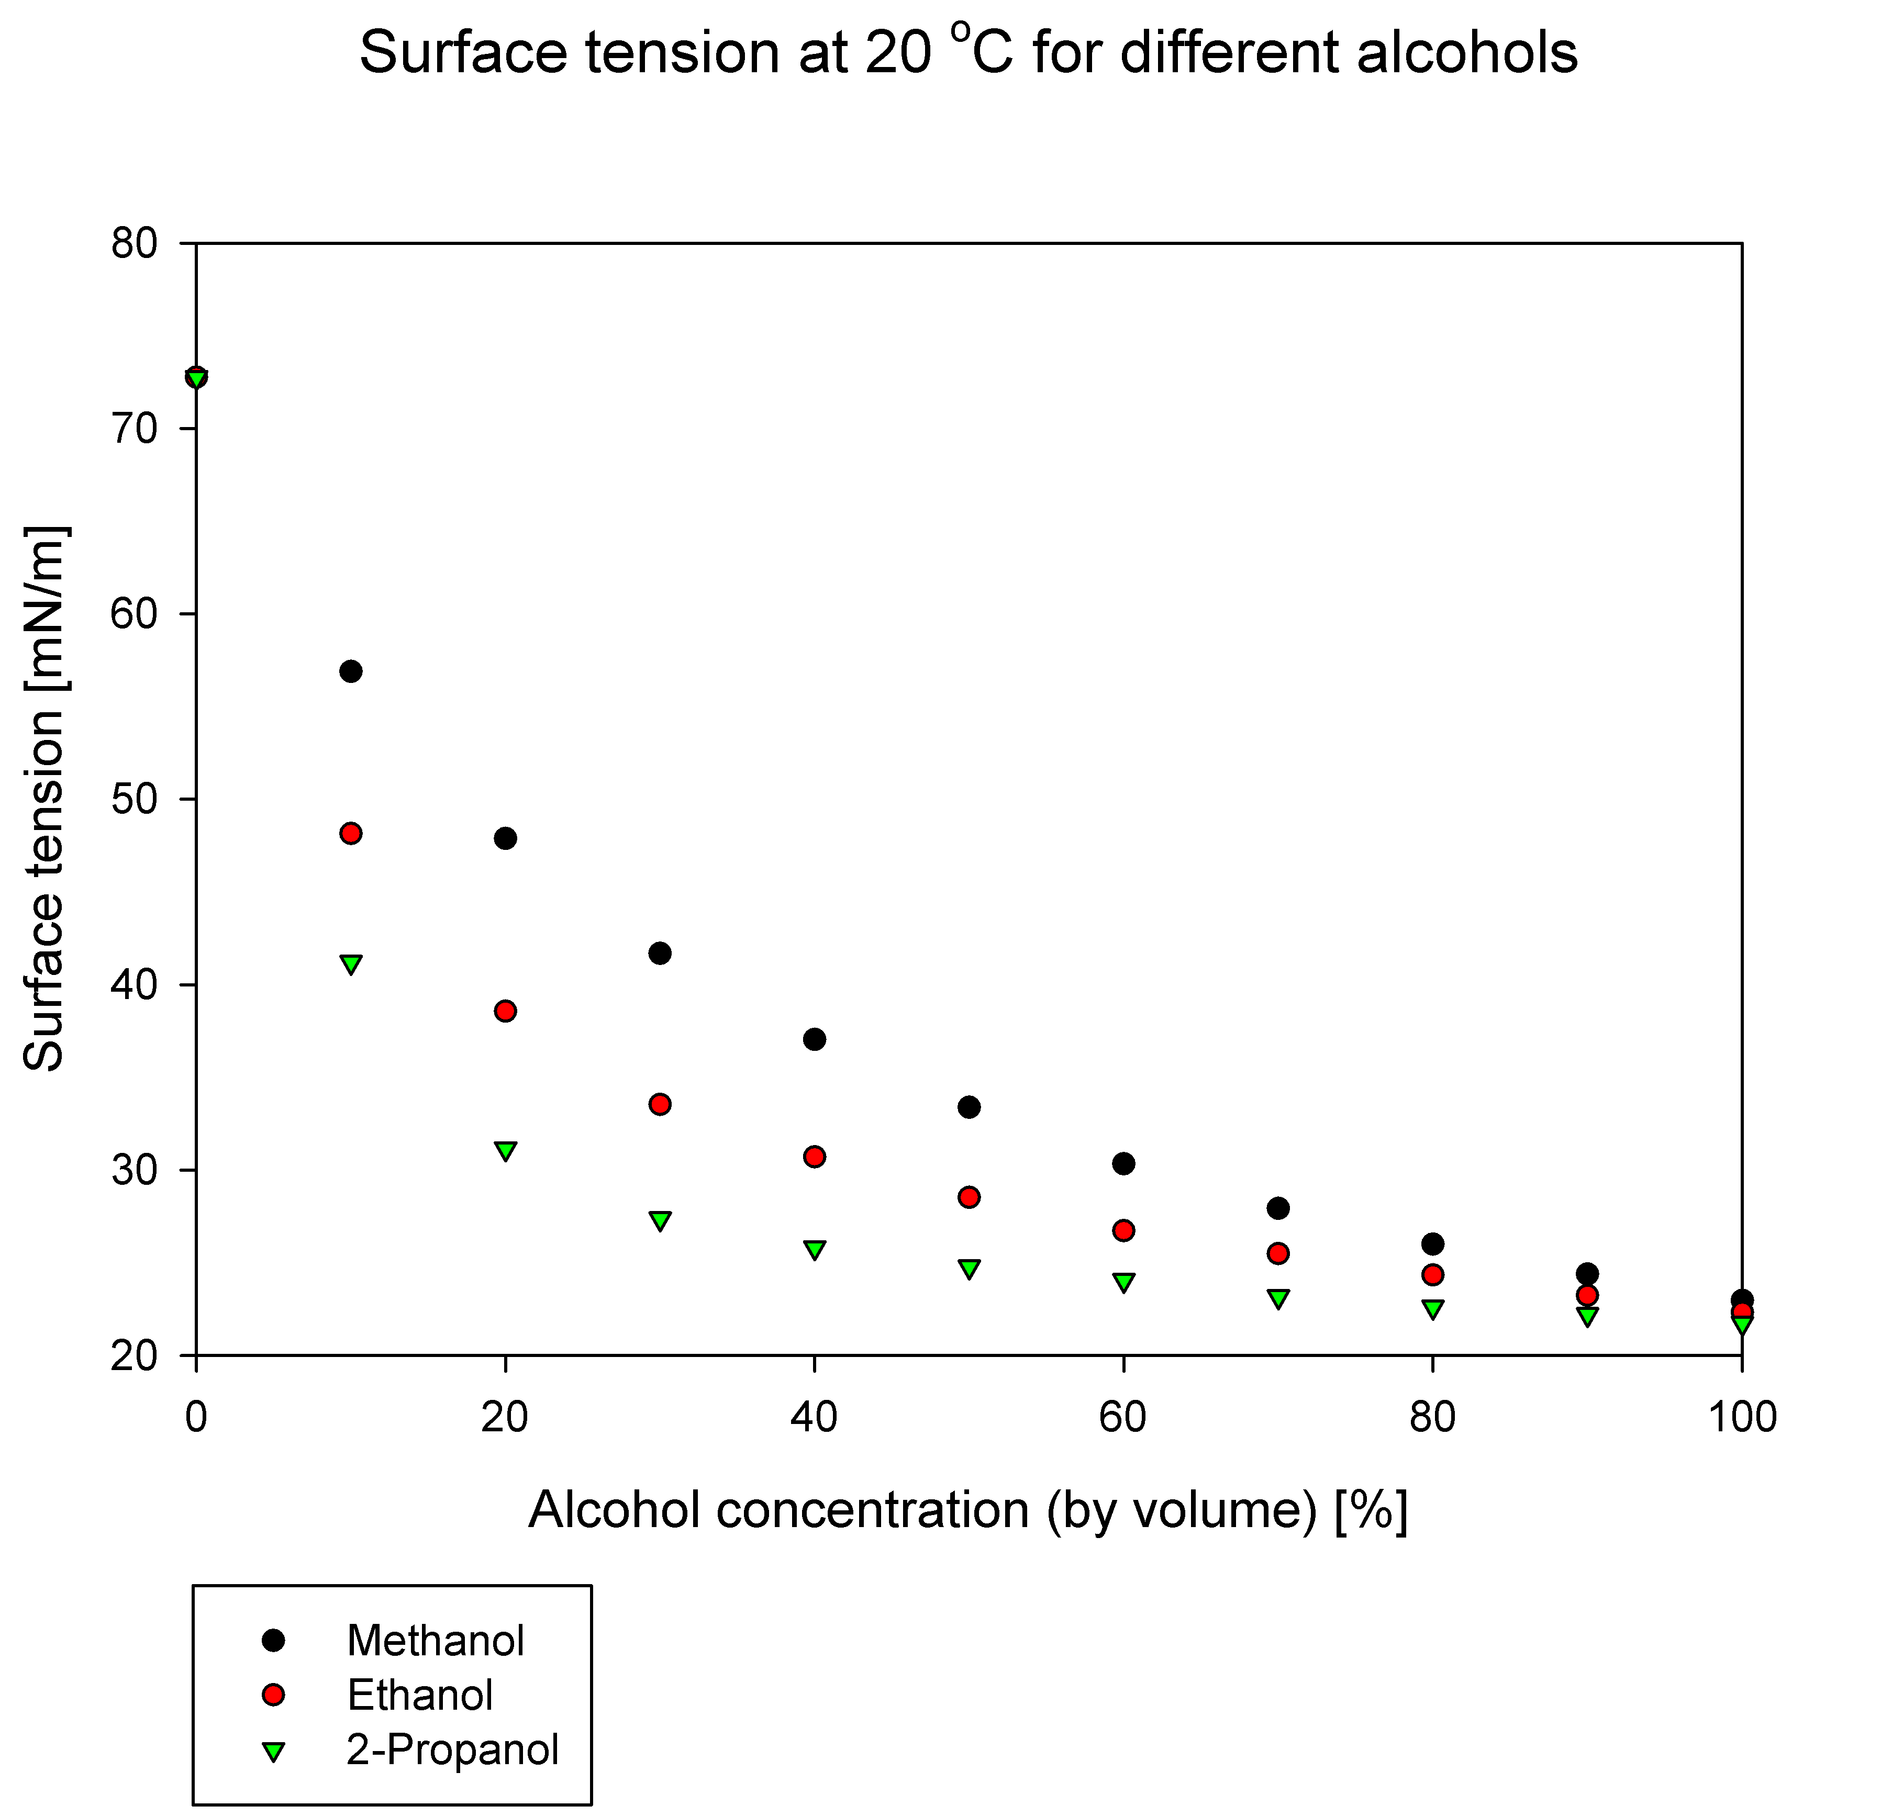
Different alcohols ($φ_{0}=80\%)$
Methanol | 25.98 mN/m
Ethanol | 25.32 mN/m
IPA | 23.21 mN/m
IYPT 2022 Droplet Explosion – Analysis of Results 28

Slide 31
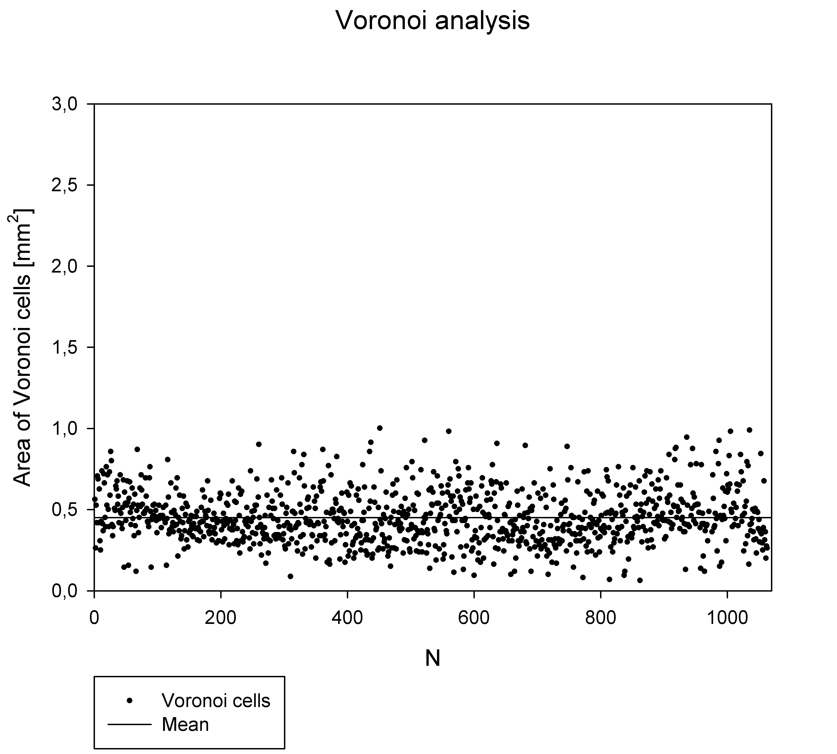
Regularity of fragmentation
IYPT 2022 Droplet Explosion – Analysis of Results 29

Slide 32
Table of Contents
Problem Description
Analysis of Results
Conclusions
Theoretical Model
Experiment Setup

Slide 33
Conclusion
Theoretical model:
Gradient of temperature and concentration
Surface tension gradient -> Marangoni stress
Speed of droplet expansion
Boundary instabilities and Young-Laplace equation
Experimental results:
Maximal radius good qualitative congurence
Effects of alcohol concetration on fragmentation (fingering, droplet size and area)
Tested for various alcohols (methanol, ethanol, IPA)
Analised the regularity of fragmentation
IYPT 2022 Droplet Explosion – Conclusions 29

Slide 34
Literature
Paić, M. (1997). Gibanja, sile, valovi (str. 391 – 393.), Zagreb, Hrvatska: Školska knjiga
Bozorgmehr, B. and Murray, B. T. (2021). Numerical Simulation of Evaporation of Ethanol–Water Mixture Droplets on Isothermal and Heated Substrates, ACS Omega 6(19)
Keiser L. et al (2017). Marangoni Bursting: Evaporation-Induced Emulsification of Binary Mixtures on a Liquid Layer, Phys. Rev. Lett. 118
Rowlinson, J.S.; Widom, B. (1982). Molecular Theory of Capillarity., Oxford, UK: Clarendon Press.
COMSOL Microfluidics Module User’s Guide v. 5.2. COMSOL Multiphysics: COMSOL AB; Stockholm, Sweden, 2016
Vazquez, G.; Alvarez, E.; Navaza, J. M. (1995). Surface tension of alcohol + water from 20 to 50. degrees C., J. Chem. Eng. Data 40
Wang, J.-F.; Li, C.-X.; Wang, Z.-H.; Li, Z.-J.; Jiang, Y.-B. (2007). Vapor pressure measurement for water, methanol, ethanol, and their binary mixtures in the presence of an ionic liquid 1-ethyl-3-methylimidazolium dimethylphosphate., Fluid Phase Equilib. 255
Thomson, G. W. (1946). The Antoine equation for vapor-pressure data. Chem. Rev. 38
Bergman T. L., Lavine A. S., Incropera F. P. (2011). Fundamentals of Heat and Mass Transfer, 7th Edition, Hobokden, SAD: John Wiley & Sons, Inc.
Hu, H.; Larson, R. G. (2005). Analysis of the effects of Marangoni stresses on the microflow in an evaporating sessile droplet., Langmuir 21
Popov Y. O. (2005). Evaporative deposition patterns: Spatial dimensions of the deposit, Phys. Rev. E. 71
Nikolov A. D. et al (2002). Superspreading driven by Marangoni flow, Adv. in Col. and Int. Sci. 96
Levich B., Krylov V., (1969). Явления, вызванные поверхностным натяжением Ann. Rev. Fluid Mech. 1
IYPT 2022 Droplet Explosion – Conclusions 30

Slide 35
Thank you for your attention!

Slide 36
Modeliranje toka
Navier-Stokesova jednadžba:
masa
akceleracija
sila
$ρ\left[\frac{∂\vec{v}}{∂t}+\left(\vec{v}∙∇\vec{v}\right)\right]=−∇p+∇∙(μ∇\vec{v})$
gustoća
brzina i smjer protoka
gradijent tlaka
viskozne sile
$∇∙\vec{v}=0$
Pretpostavke:
Nestlačivi fluid
Kontinuirani protok
„No-slip condition”
Zanemariv utjecaj vanjskih sila (npr. gravitacije)
DTMF 2022 Kapljična eksplozija – Teoretski model 9

Slide 37
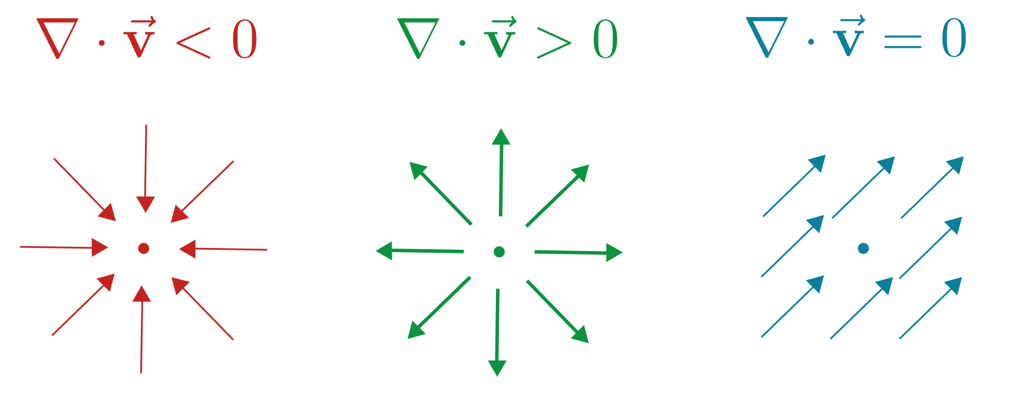
Divergencija
$$∇∙f=\frac{{∂f}_{x}}{∂x}+\frac{∂f_{y}}{∂y}+\frac{{∂f}_{z}}{∂z}$$
DTMF 2022 Kapljična eksplozija – Dodatni slajdovi 32

Slide 38
Distribucija koncentracije
Promjena koncentracije u vremenu:
$$\frac{∂c_{a}}{∂t}+\vec{v}∙∇c_{a}=∇∙\left(D_{a}∇c_{a}\right)$$
Rubni uvjeti:
$\frac{∂c_{e}}{∂r}=0$ u točki $r=0$
$\frac{∂c_{e}}{∂n}=0$ u točki $z=0$
$\frac{∂c_{e}}{∂n}=−J_{a}$ u točki $z=h(r,t)$
DTMF 2022 Kapljična eksplozija – Dodatni slajdovi 33

Slide 39
Temperature distribution
Fourier-Biot equation:
$$ρκ\left(\frac{∂T}{∂t}+\vec{v}∙∇T\right)=∇∙\left(λ∇T\right.)$$
Boundary conditions:
$T = T_{o}$ for initial environment
$T=T_{H2O}$ for $(z∈\left[0,h_{0}\right])∩(rε\left[0,r_{0}\right])$
$∆H=−J_{H2O}L_{H2O}−J_{a}L_{a}$ in point $z=h(r,t)$
DTMF 2022 Kapljična eksplozija – Dodatni slajdovi 34

Slide 40
Alcohol evaporation
Diffusion equations:
$$\frac{∂k_{p,H2O}}{∂t}=∇∙\left(D_{p,H2O}∇k_{p,h2O}\right)$$
$$\frac{∂k_{p, a}}{∂t}=∇∙\left(D_{p,a}∇k_{p,a}\right)$$
Boundary conditions:
$$J_{H2O}=−M_{H2O}D_{H2O}∇_{n}k_{p,H2O}$$
$$J_{a}=−M_{a}D_{a}∇_{n}k_{p,a}$$
DTMF 2022 Kapljična eksplozija – Dodatni slajdovi 35

Slide 41
Droplet fragmentation
Plateau-Rayleigh instability:
Young-Laplace equation:
$$2πR_{0}=nλ$$
$$∆p=σ\left(\frac{1}{R_{1}}+\frac{1}{R_{2}}\right)$$
$$r_{0}$$
$$\frac{R_{0}}{r_{0}}$$
$$R_{0}$$
$$R_{0}$$
$$p_{o}$$
$$p_{i}$$
$$R$$
$$∆R$$
$$∆p=\frac{σ}{R}$$
$$σ \sim R$$
Pairam, E.; Fernández-Nieves, A. (2009). Generation and Stability of Toroidal Droplets in a Viscous Liquid. Phys. Rev. Lett., 102(23)
DTMF 2022 Kapljična eksplozija – Teoretski model 13

Slide 42
Kontaktni kut
Liu, Chuanjun; Bonaccurso, Elmar; Butt, Hans-Jürgen (2008). Evaporation of sessile water/ethanol drops in a controlled environment. Physical Chemistry Chemical Physics, 10(47)
DTMF 2022 Kapljična eksplozija – Dodatni slajdovi 36

Slide 43
Volume and contact angle
Liu, Chuanjun; Bonaccurso, Elmar; Butt, Hans-Jürgen (2008). Evaporation of sessile water/ethanol drops in a controlled environment. Physical Chemistry Chemical Physics, 10(47)
DTMF 2022 Kapljična eksplozija – Dodatni slajdovi 37

Slide 44
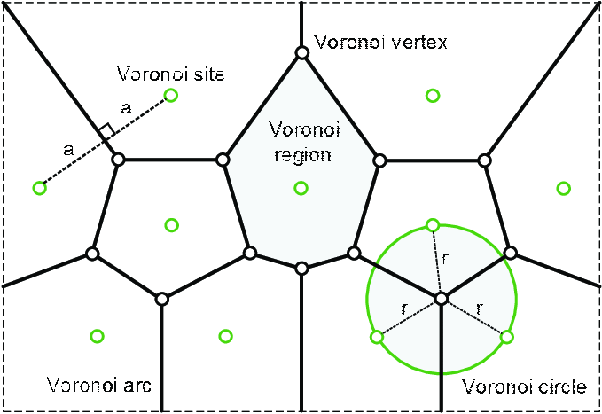
Voronoi dijagram
DTMF 2022 Kapljična eksplozija – Dodatni slajdovi 38

Slide 45
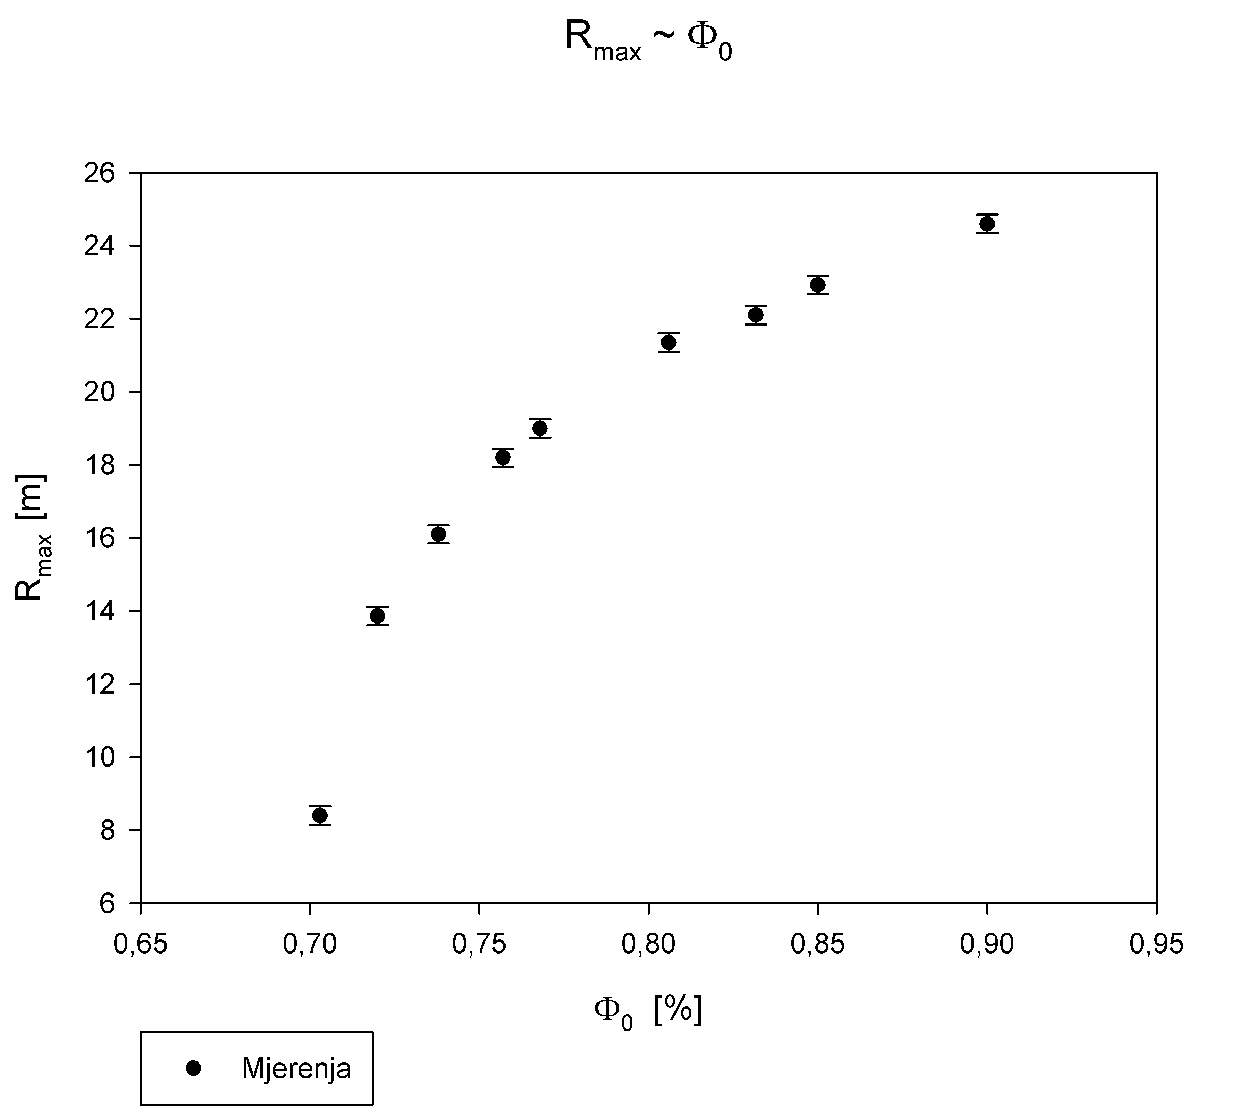
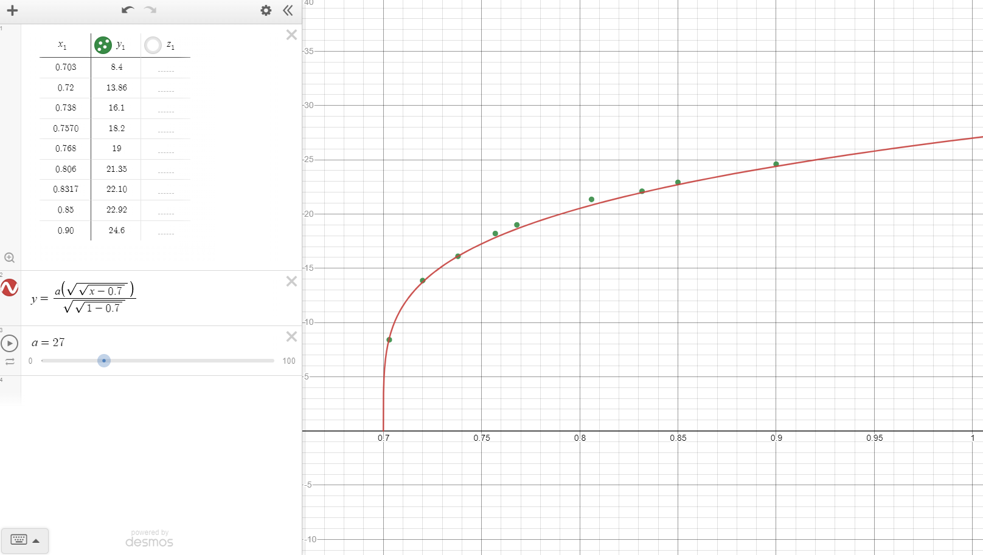
$$R_{max} \sim φ_{al.}$$
$$R_{max} \sim 0.28{\left[\frac{\left(Φ_{0}−Φ_{c}\right)∆γHΩ_{0}}{\left(1−Φ_{c}\right)μ_{0}j_{v}}\right]}^{\frac{1}{4}}$$
DTMF 2022 Kapljična eksplozija – Analiza rezultata 23

Slide 46
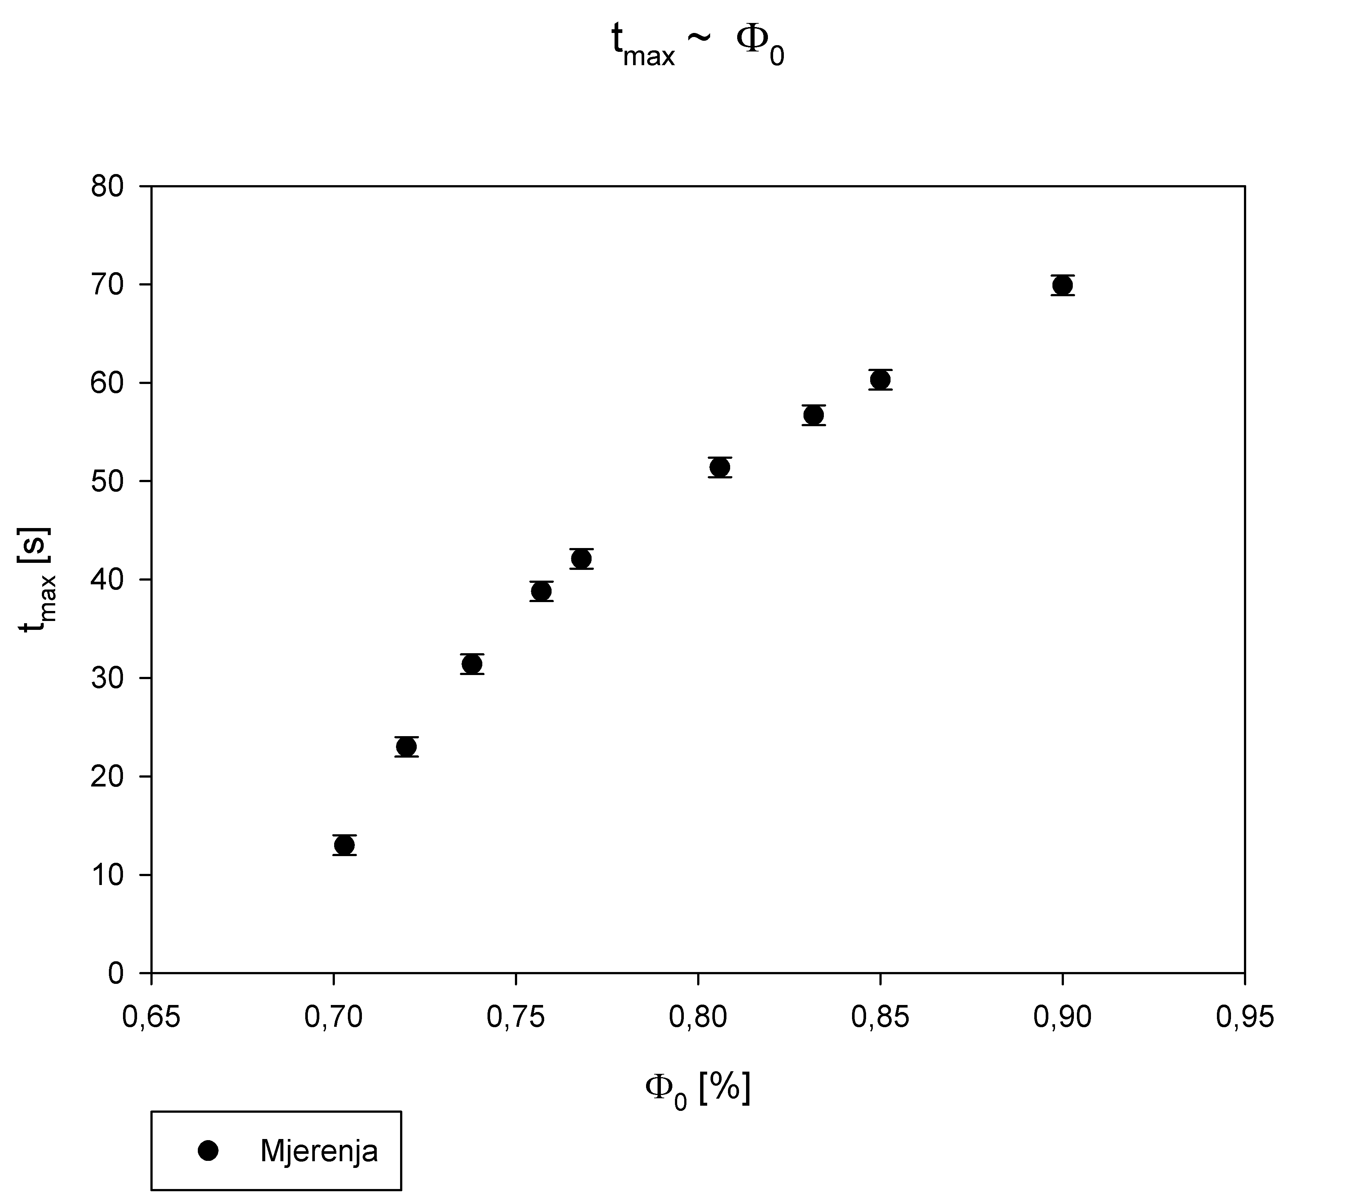
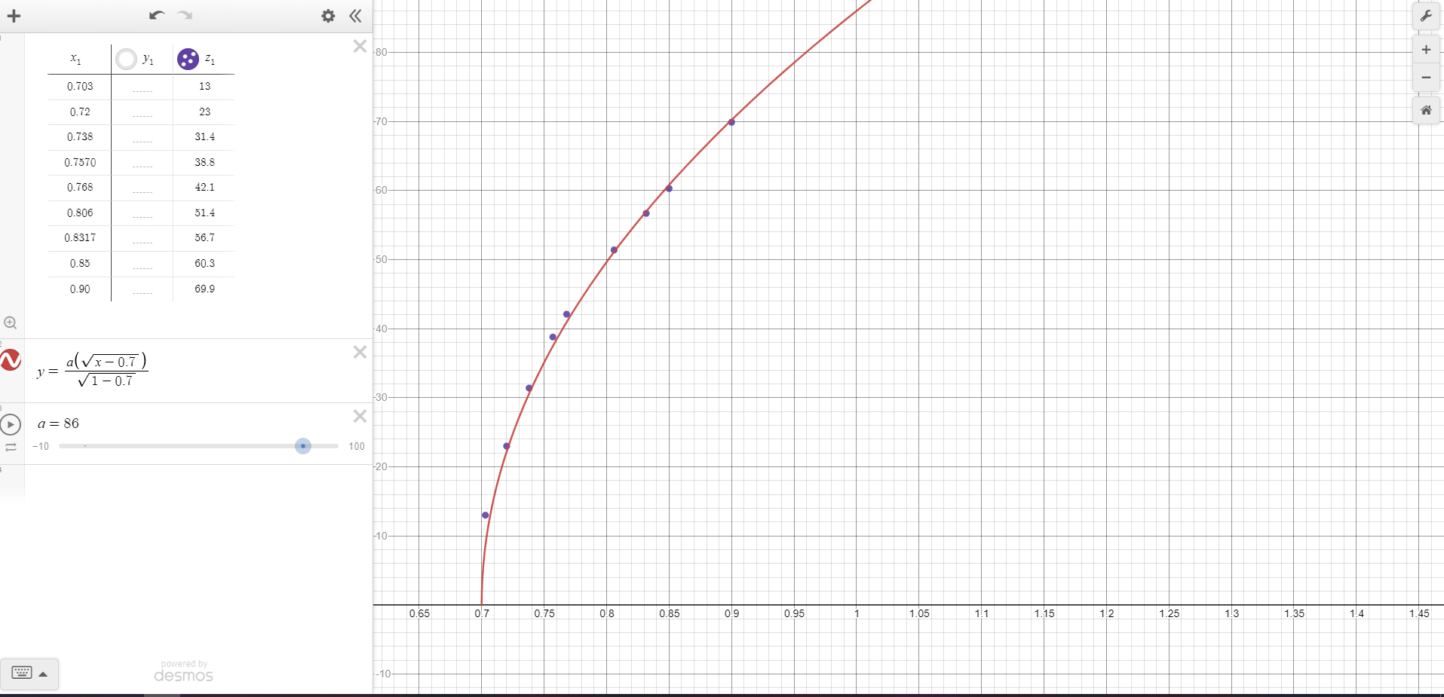
$$t_{max} \sim φ_{al.}$$
$$τ \sim {\left[\frac{\left(Φ_{0}−Φ_{c}\right)μ_{0}Ω_{0}}{\left(1−Φ_{c}\right)∆γHj_{v}}\right]}^{\frac{1}{2}}$$
$$τ \sim {\left[\frac{\left(Φ_{0}−0.7\right)}{\left(1−0.7\right)}\right]}^{\frac{1}{2}}$$
DTMF 2022 Kapljična eksplozija – Analiza rezultata 24

